Slide 1
Introduction to
Green and Complete Streets

Slide 2
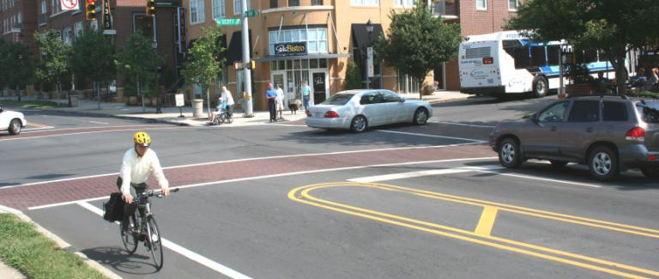
What are Complete Streets?
Complete Streets are streets for everyone, no matter who they are or how they travel.
Notes:
The streets of our cities and towns are an important part of our communities. They allow children to get to school and parents to get to work. They bring together neighbors and draw visitors to neighborhood stores. These streets ought to be designed for everyone – whether young or old, on foot or on bicycle, in a car or in a bus – but too often they are designed only for speeding cars or creeping traffic jams.
Now, in communities across the country, a movement is growing to “complete” the streets. States, cities, and towns are asking their planners and engineers to build roads that are safer, more accessible, and easier for everyone. In the process, they are creating better communities for people to live, play, work, and shop.
Photo: Charlotte NC DOT

Slide 3
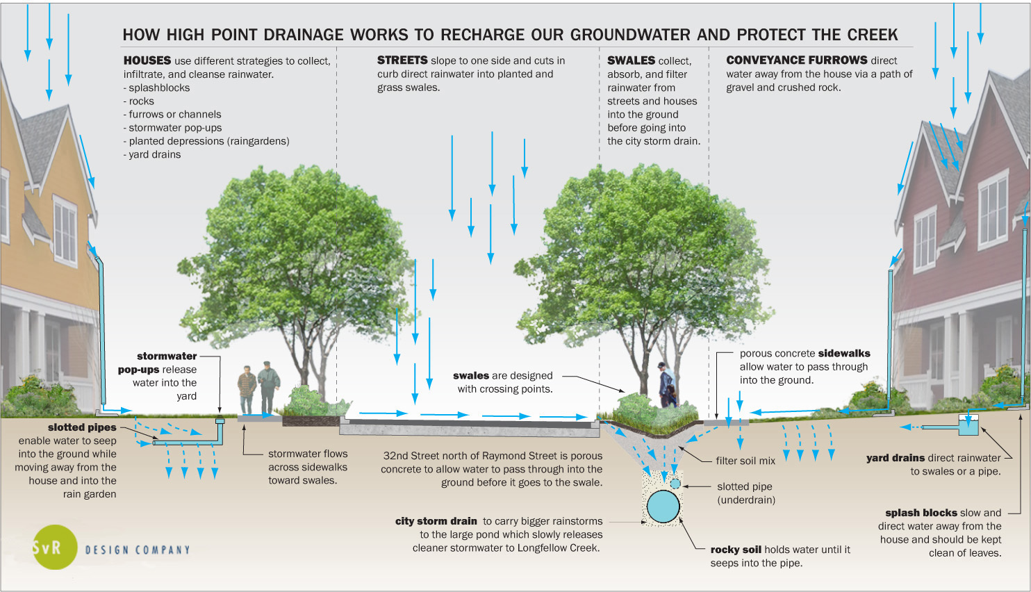
What are Green Streets?
Notes:
https://www.google.com/url?sa=i&rct=j&q=&esrc=s&source=images&cd=&cad=rja&uact=8&ved=0ahUKEwidycepo-nXAhWJNd8KHeaRD-0QjRwIBw&url=http%3A%2F%2Fstrafford.org%2Fmagazine%2Fgreen-infrastructure-success-stories%2F&psig=AOvVaw20KwOkzBiRUNAHNwcao7BF&ust=1512233595100358
Photos, L-R: Pamela Palma, pedbikeimages.org; Dan Burden, Walkable and Livable Communities Institute;

Slide 4
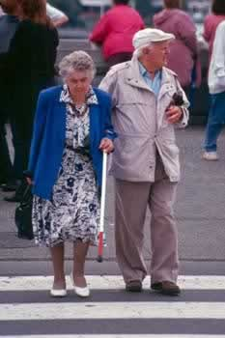
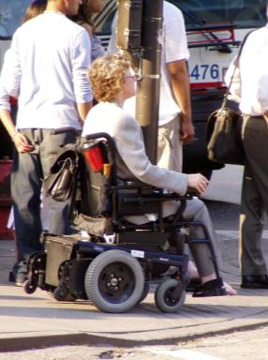

What are Complete Streets?
Safe Comfortable Convenient
Notes:
Complete Streets make it easy to cross the street, walk to shops, and bicycle to work. They allow buses to run on time and make it safe for people to walk to and from train stations.
RECREATION AREAS NOT IN CENTER OF CITY
Photos (all): Dan Burden, Walkable and Livable Communities Institute

Slide 5
Issues with conventional streets
Fail to meet ADA requirements
Limit recreation opportunities downstream
Infrequent crosswalks put pedestrians in danger
Lack of bicycle facilities creates dangerous situations for cyclists
They’re unattractive

Slide 6
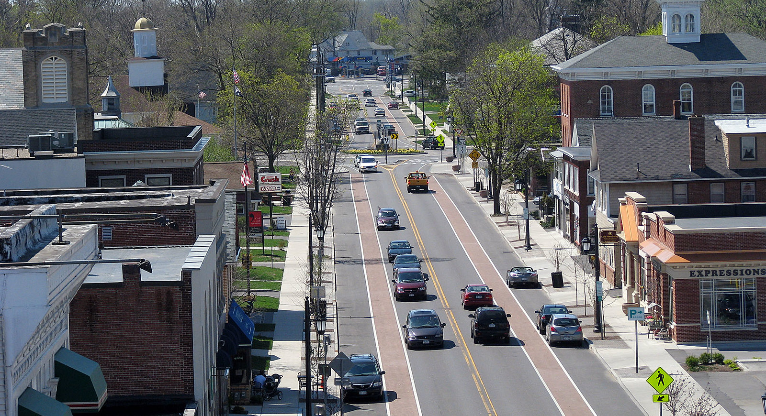
We know how to build right

Slide 7
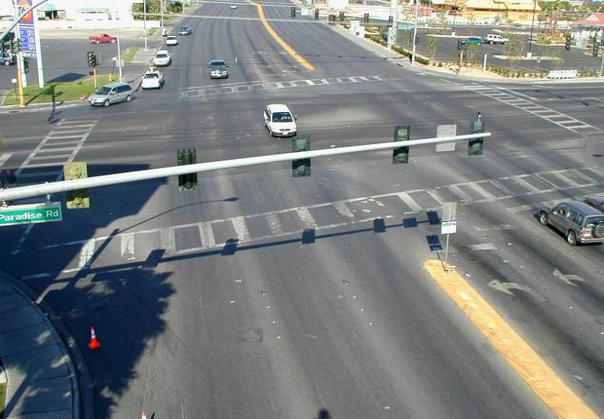
Yet too many roads still turn out like this:

Slide 8
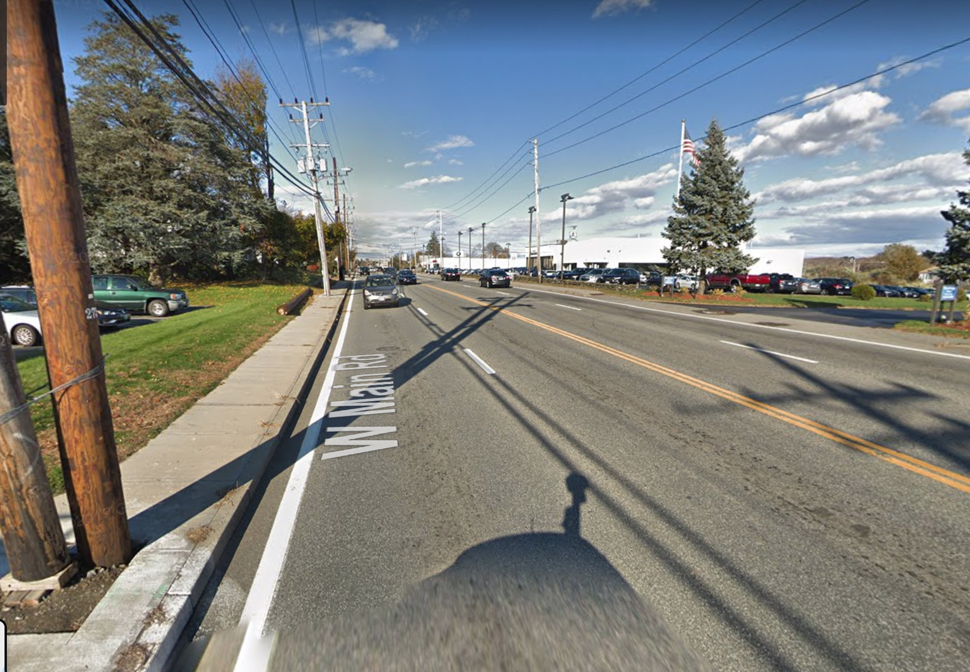
Or this:

Slide 9
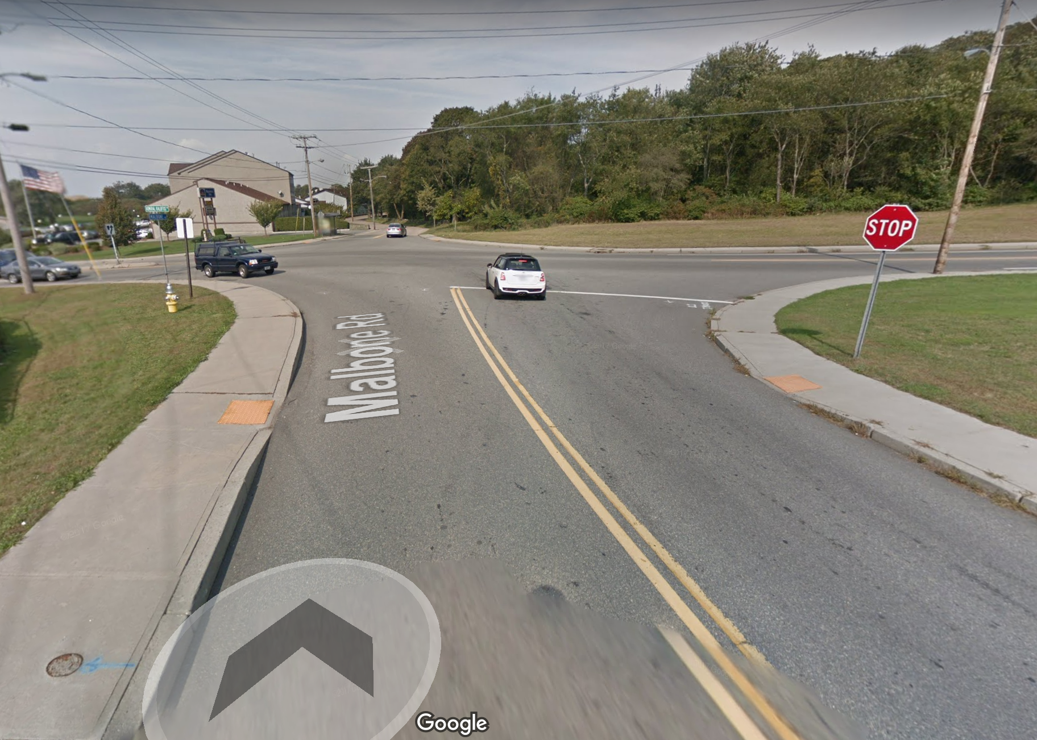
or this:

Slide 10
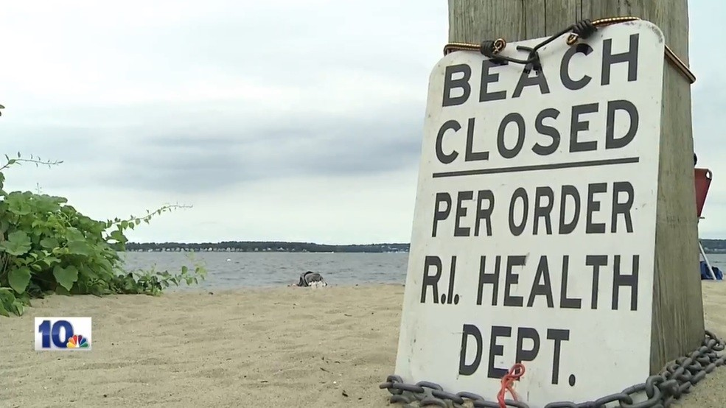

Slide 11
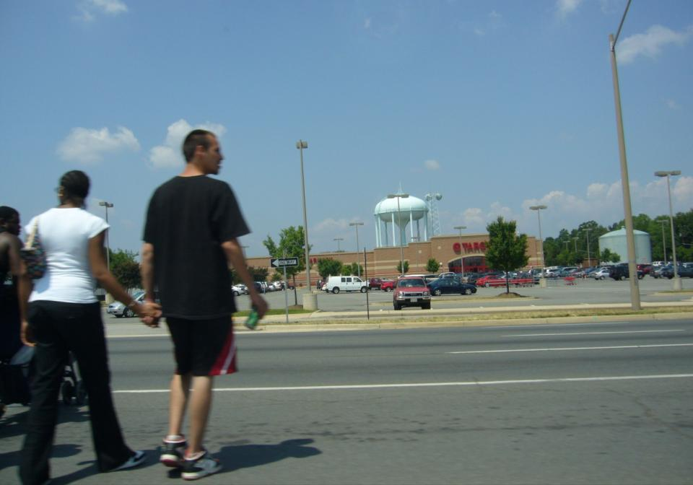
More than 40% of pedestrian deaths in 2007 and 2008 occurred where no crosswalk was available.
National Highway Traffic Safety Administration’s Fatality Reporting System
Notes:
More than half of 45,284 pedestrian deaths between 2003 and 2012 occurred on arterial roadways, typically designed to be wide and fast. Over 60% of pedestrian fatalities were on roads with a speed limit of 40 mph or higher. (These datapoints are based on deaths in which roadway classification and speed was recorded.) Roads like these are built to move cars and too often do not have meet the needs of pedestrian or bicyclist safety.
Source: National Highway Traffic Safety Administration’s Fatality Analysis Reporting System, Dangerous By Design 2014,
Photo: Cheryl Cort, Coalition for Smarter Growth, Virginia

Slide 12
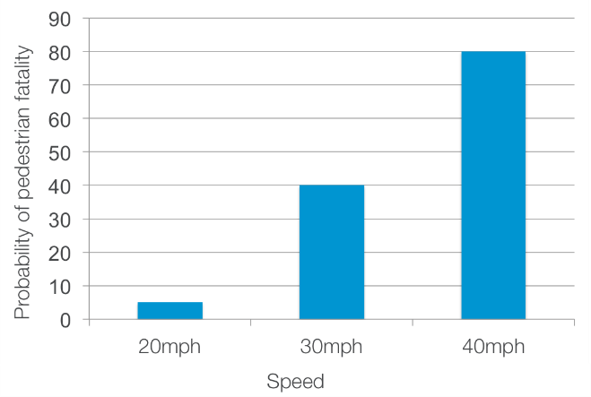
Benefits: Safety
Slower speeds = improved safety
W.A. Leaf and D.F. Preusser, “Literature Review on Vehicle Travel Speeds and Pedestrian Injuries Among Selected Racial/Ethnic Groups,” US Department of Transportation, National Highway Traffic Safety Administration (1999).
Notes:
When a pedestrian is hit by a car going 40mph, the likelihood of death is 80 percent. If the car is going 30mph, the likelihood drops to 40 percent and if the car is going 20mph, the likelihood drops to 5 percent.
3 PEDESTRIAN FATALITIES IN LAST 3 YEARS
Source: W.A. Leaf and D.F. Preusser, “Literature Review on Vehicle Travel Speeds and Pedestrian Injuries Among Selected Racial/Ethnic Groups,” US Department of Transportation, National Highway Traffic Safety Administration (1999).

Slide 13
Health
“A comprehensive study of walkability has found that people in walkable neighborhoods did about 35–45 more minutes of moderate intensity physical activity per week and were substantially less likely to be overweight or obese than similar people living in low-walkability neighborhoods.”
“The Centers for Disease Control and Prevention names improved traffic safety, and Complete Streets policies specifically, as an important strategy in tackling the obesity epidemic”
Notes:
http://www.cdc.gov/obesity/downloads/community_strategies_guide.pdf
(Sallis, J. F., et al. (2009). Neighborhood built environment and income: Examining multiple health outcomes. Social Science and Medicine, 68, 1285–1293

Slide 14
Benefits: Health
Risk of obesity:
Increases
6% for each hours spent in a car.
Decreases 4.8% for each additional kilometer walked.
Frank, L., et. al. (2004). Obesity Relationships with Community Design, Physical Activity, and Time Spent in Cars. American Journal of Preventative Medicine 27(2).

Slide 15
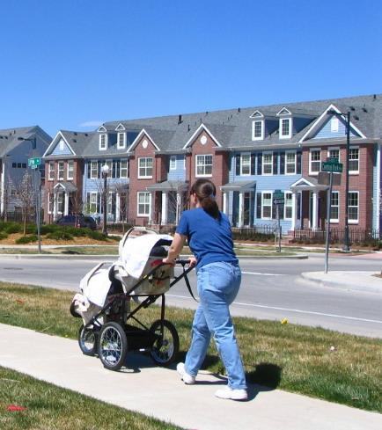
Benefits: Health
Women who walk or bike 30 minutes a day have a lower risk of breast cancer.
A 30-minute round-trip bicycle commute is associated with better mental health in men.
People who live in walkable neighborhoods get more exercise than those who do not.
Notes:
Photo: Dan Burden, Walkable and Livable Communities Institute
Sources: American Public Health Association
Luoto, R., et al. 2000. The effect of physical activity on breast cancer risk: A cohort study of 30,548 women. European Journal of Epidemiology, 16, 973-80.
Ohta, M., et al., 2007. Effect of the physical activities in leisure time and commuting to work on mental health. Journal of Occupational Health, 49, 46-52.
Dill, Jennifer and Theresa Carr. (2003). “Bicycle Commuting and Facilities in Major US Cities: If You Build Them, Commuters Will Use Them.” Transportation Research Record: Journal of the Transportation Research Board, No. 1828, TRB, 2003, pp 116-123.

Slide 16
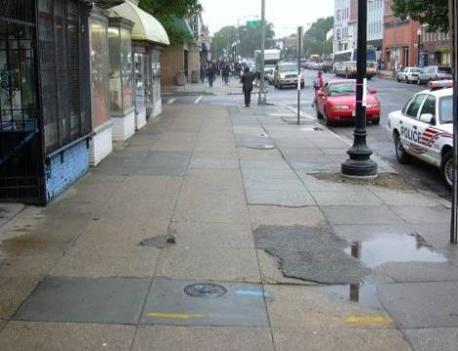
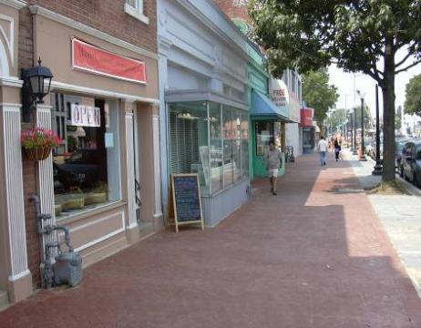
Benefits: Economy
Washington, DC: Barracks Row/8th Street SE
$8 milllion public investment in streetscape improvements 2003-2004
$8 million in private investment in following two years
32 new business establishments
$80,000 in sales tax annually
Notes:
In 1999 when local merchants, residents and property owners came together to create the Barracks Row Alliance (now Barracks Row Main Street), things looked good: crime numbers were dropping, home sales were rising, new employment was coming - but businesses were not. DDOT worked with the main street organization, Advisory Neighborhood Commissions, and residents to develop a signature streetscape and spent $8 million in the area. That investment was one factor that helped give Barracks Row the extra edge it needed to really begin to attract new businesses and investment. It created an environment that felt safe and looked like a special place.
Source: District Office of Planning, Transportation Research Board Circular E-C100, Linking Transportation and Land Use: A Peer Exchange. July 12-13, 2005.

Slide 17
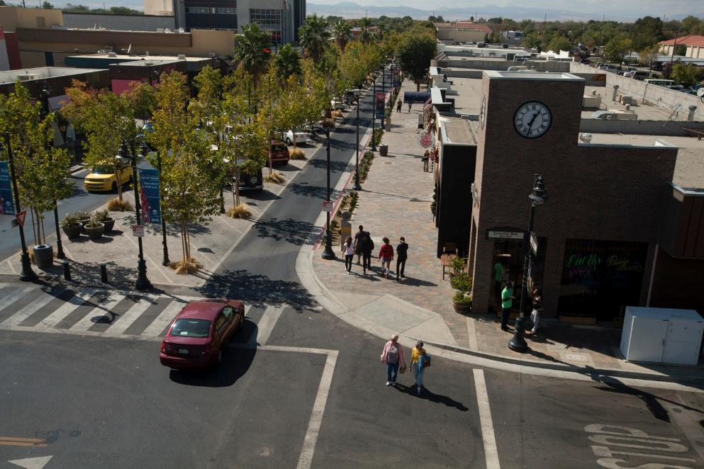
Benefits: Economy
Lancaster, California:
  Reduced speeding
  Fewer crashes
  50 new businesses
  800 new jobs
  Vacancy rate: just 4%
  Sales tax revenue: up 26%
Notes:
The city used a Complete Streets approach for its 2010 redesign of Lancaster Boulevard, rebranded as The BLVD. The nine-block revitalization project invites visitors walk or bicycle from store to store. It features a center plaza for walking and community events, angled parking, enhanced crosswalks, abundant landscaping and lighting, and outdoor seating.
Lancaster’s redesign revitalized the city’s commercial core while making the street safer and more inviting for people walking and biking. Automobile traffic on The BLVD remains steady but at a speed that allows people walking and biking to feel comfortable. Overall traffic collisions are down 50 percent and injury-related collisions plummeted 85 percent.
The project has also spurred economic investment and job growth in the area. The BLVD was awarded the U.S. Environmental Protection Agency’s 2012 Smart Growth award for Overall Excellence.
Source:
City of Lancaster
California Redevelopment Association IMPLAN Jobs Calculator
U.S. EPA
Photo: U.S. EPA

Slide 18
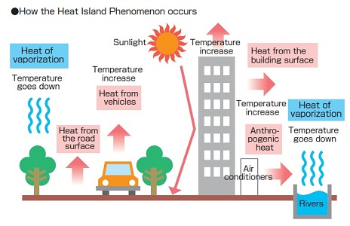
Benefits: Heat Island Effect

Slide 19
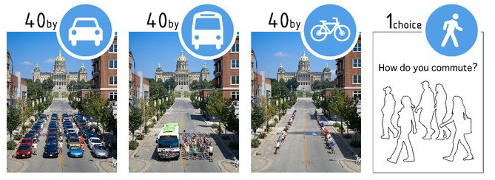
Benefits: Capacity
Newport’s density and narrow streets create limited space for motor vehicles
Notes:
Source: www.tobinbennett.com, Des Moines, Iowa- August 2010. More info at www.facebook.com/Urban.Ambassadors
Expanding automobile capacity as a means to alleviate congestion woes has not worked- In California, adding road capacity through additional lanes and mileage on state highways did not result in less congestion. Instead, sixty to seventy percent of increased road capacity was filled with new automobile traffic within just five years; at the municipal level, 90% was filled over the same period.
As we have learned, half of all trips taken in the U.S. are under three miles and nearly 30 percent of all trips are less than one mile. Providing travel choices- through improved pedestrian and bicycle access and improved public transportation service- can reduce the number of trips made in cars at peak congestion hours. For instance, parents who are concerned it is unsafe for their children to walk or bike to school, often choose to drive them, even though the trip may be a short one. These trips occur during peak congestion hours and add to automobile congestion. Complete Streets provides safer choices for children to commute to school, which eases congestion for drivers going longer distances because they are not competing for space on the road with drivers going short distances.
As this photo shows, public transportation, walking, or biking take up less space on the road than driving. Complete streets can move more people while using less space. Getting more productivity out of the existing road and public transportation systems is vital to reducing congestion.
Sources: Hansen, Mark and Yuanlin Huang. (1997). “Road Supply and Traffic in California Urban Areas,” Transportation Research A, Vol. 31, No. 3, 1997, pp. 205-218.
Schrank, David and Lomax, T. (2009) Urban Mobility Report. Texas Transportation Institute.

Slide 20
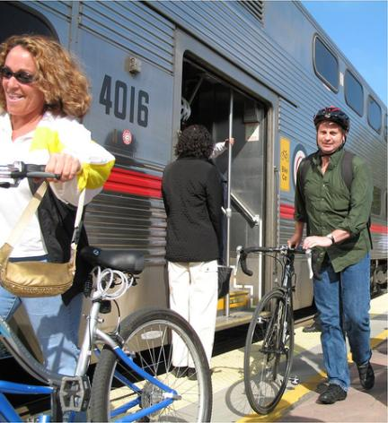
Benefits: Provide Choices
Transportation is second largest expense for families: ~18% of budget
Low income households can spend up to 55% of budget on transportation.
Complete Streets give people more control over their expenses.
Notes:
Studies on housing and transportation costs show that, across the country, the there are far fewer affordable neighborhoods when you account for transportation costs in addition to housing costs. In Portland, OR, the city’s Complete Streets efforts help residents save $1.1 billion a year total, or roughly 1.5% of all personal income earned. The benefits of inexpensive housing can be offset by higher transportation costs if households have to rely on one mode of transportation: the personal automobile. In cities implementing Complete Streets policies, residents can drive less, take shorter trips, and use more public transit – saving them money each trip. Households with access to good transit service can spend only 9 percent of their budget on transportation costs.
Sources:
U.S. Environmental Protection Agency. (2012). Smart Growth and Economic Success: Benefits for Real Estate Developers, Investors, Businesses, and Local Governments. http://www.epa.gov/smartgrowth/pdf/economic_success.pdf
Center for Neighborhood Technology. H + T Affordability Index. H+T Affordability Index. http://htaindex.cnt.org.
CEOs for Cities. (2007). Portland’s Green Dividend. Cortwright, J. http://www.ceosforcities.org/citydividends/green/special-reports/portland.
Center for Transit-Oriented Development. Mixed-Income Housing Near Transit. 2009. http://www.reconnectingamerica.org/resource-center/browse-research/2009/tod-201-mixed-income-housing-near-transit-increasing-affordability-with-location-efficiency/
Data: U.S. Bureau of Labor Statistics, Consumer Expenditure Survey 2010
Photo: Richard Masoner, http://www.cyclelicio.us/

Slide 21
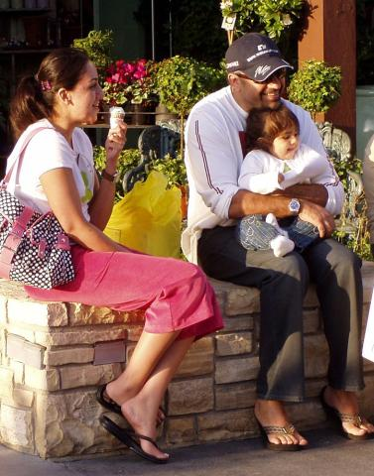
Benefits: Livable Communities
Walkable communities = happier communities
Residents of walkable communities:
are more likely to be socially engaged and trusting
report being in good health and happy more often
Shannon H. Rogers, et al. Examining Walkability and Social Capital as Indicators of Quality of Life at the Municipal and Neighborhood Scales. (2010)
Notes:
A study from Texas of people who moved to walkable community, found that the people who moved had a higher number of social interactions, such saying hello or chatting with a neighbor, or asking to borrow items. They also felt that they could count on their neighbors if they needed to, and that their neighborhood was “close-knit”.
Sources: Shannon H. Rogers, John M. Halstead, Kevin H. Gardner and Cynthia H. Carlson. Examining Walkability and Social Capital as Indicators of Quality of Life at the Municipal and Neighborhood Scales. (2010). Applied Research in Quality of Life, published online 28 Oct 2010.
Zhu X, Yu CY, Lee C, Lu Z, Mann G. A retrospective study on changes in residents’ physical activities, social interactions, and neighborhood cohesion after moving to a walkable community (2014) Preventive Medicine, publishes online Aug 23 2014.
Photo: Dan Burden, Walkable and Livable Institute, walklive.org

Slide 22
The tremendous potential
Of all trips:
50% are less than 3 miles
28% are less than
1 mile
60%
are driven
of these trips…
National Household Travel Survey (2009)
Notes:
Tremendous potential for to convert short trips from driving to walking/bicycling.
Data: NHTS
Figures: 49.5%; 27.9%; 59.9%
22

Slide 23
Benefits of Green and Complete Streets
Reduced speeds reduce injuries
Reduces obesity, asthma, and cancer
Improves mental health and citizen engagement
Reduces transportation and cooling costs
Spurs private investment and business development

Slide 24
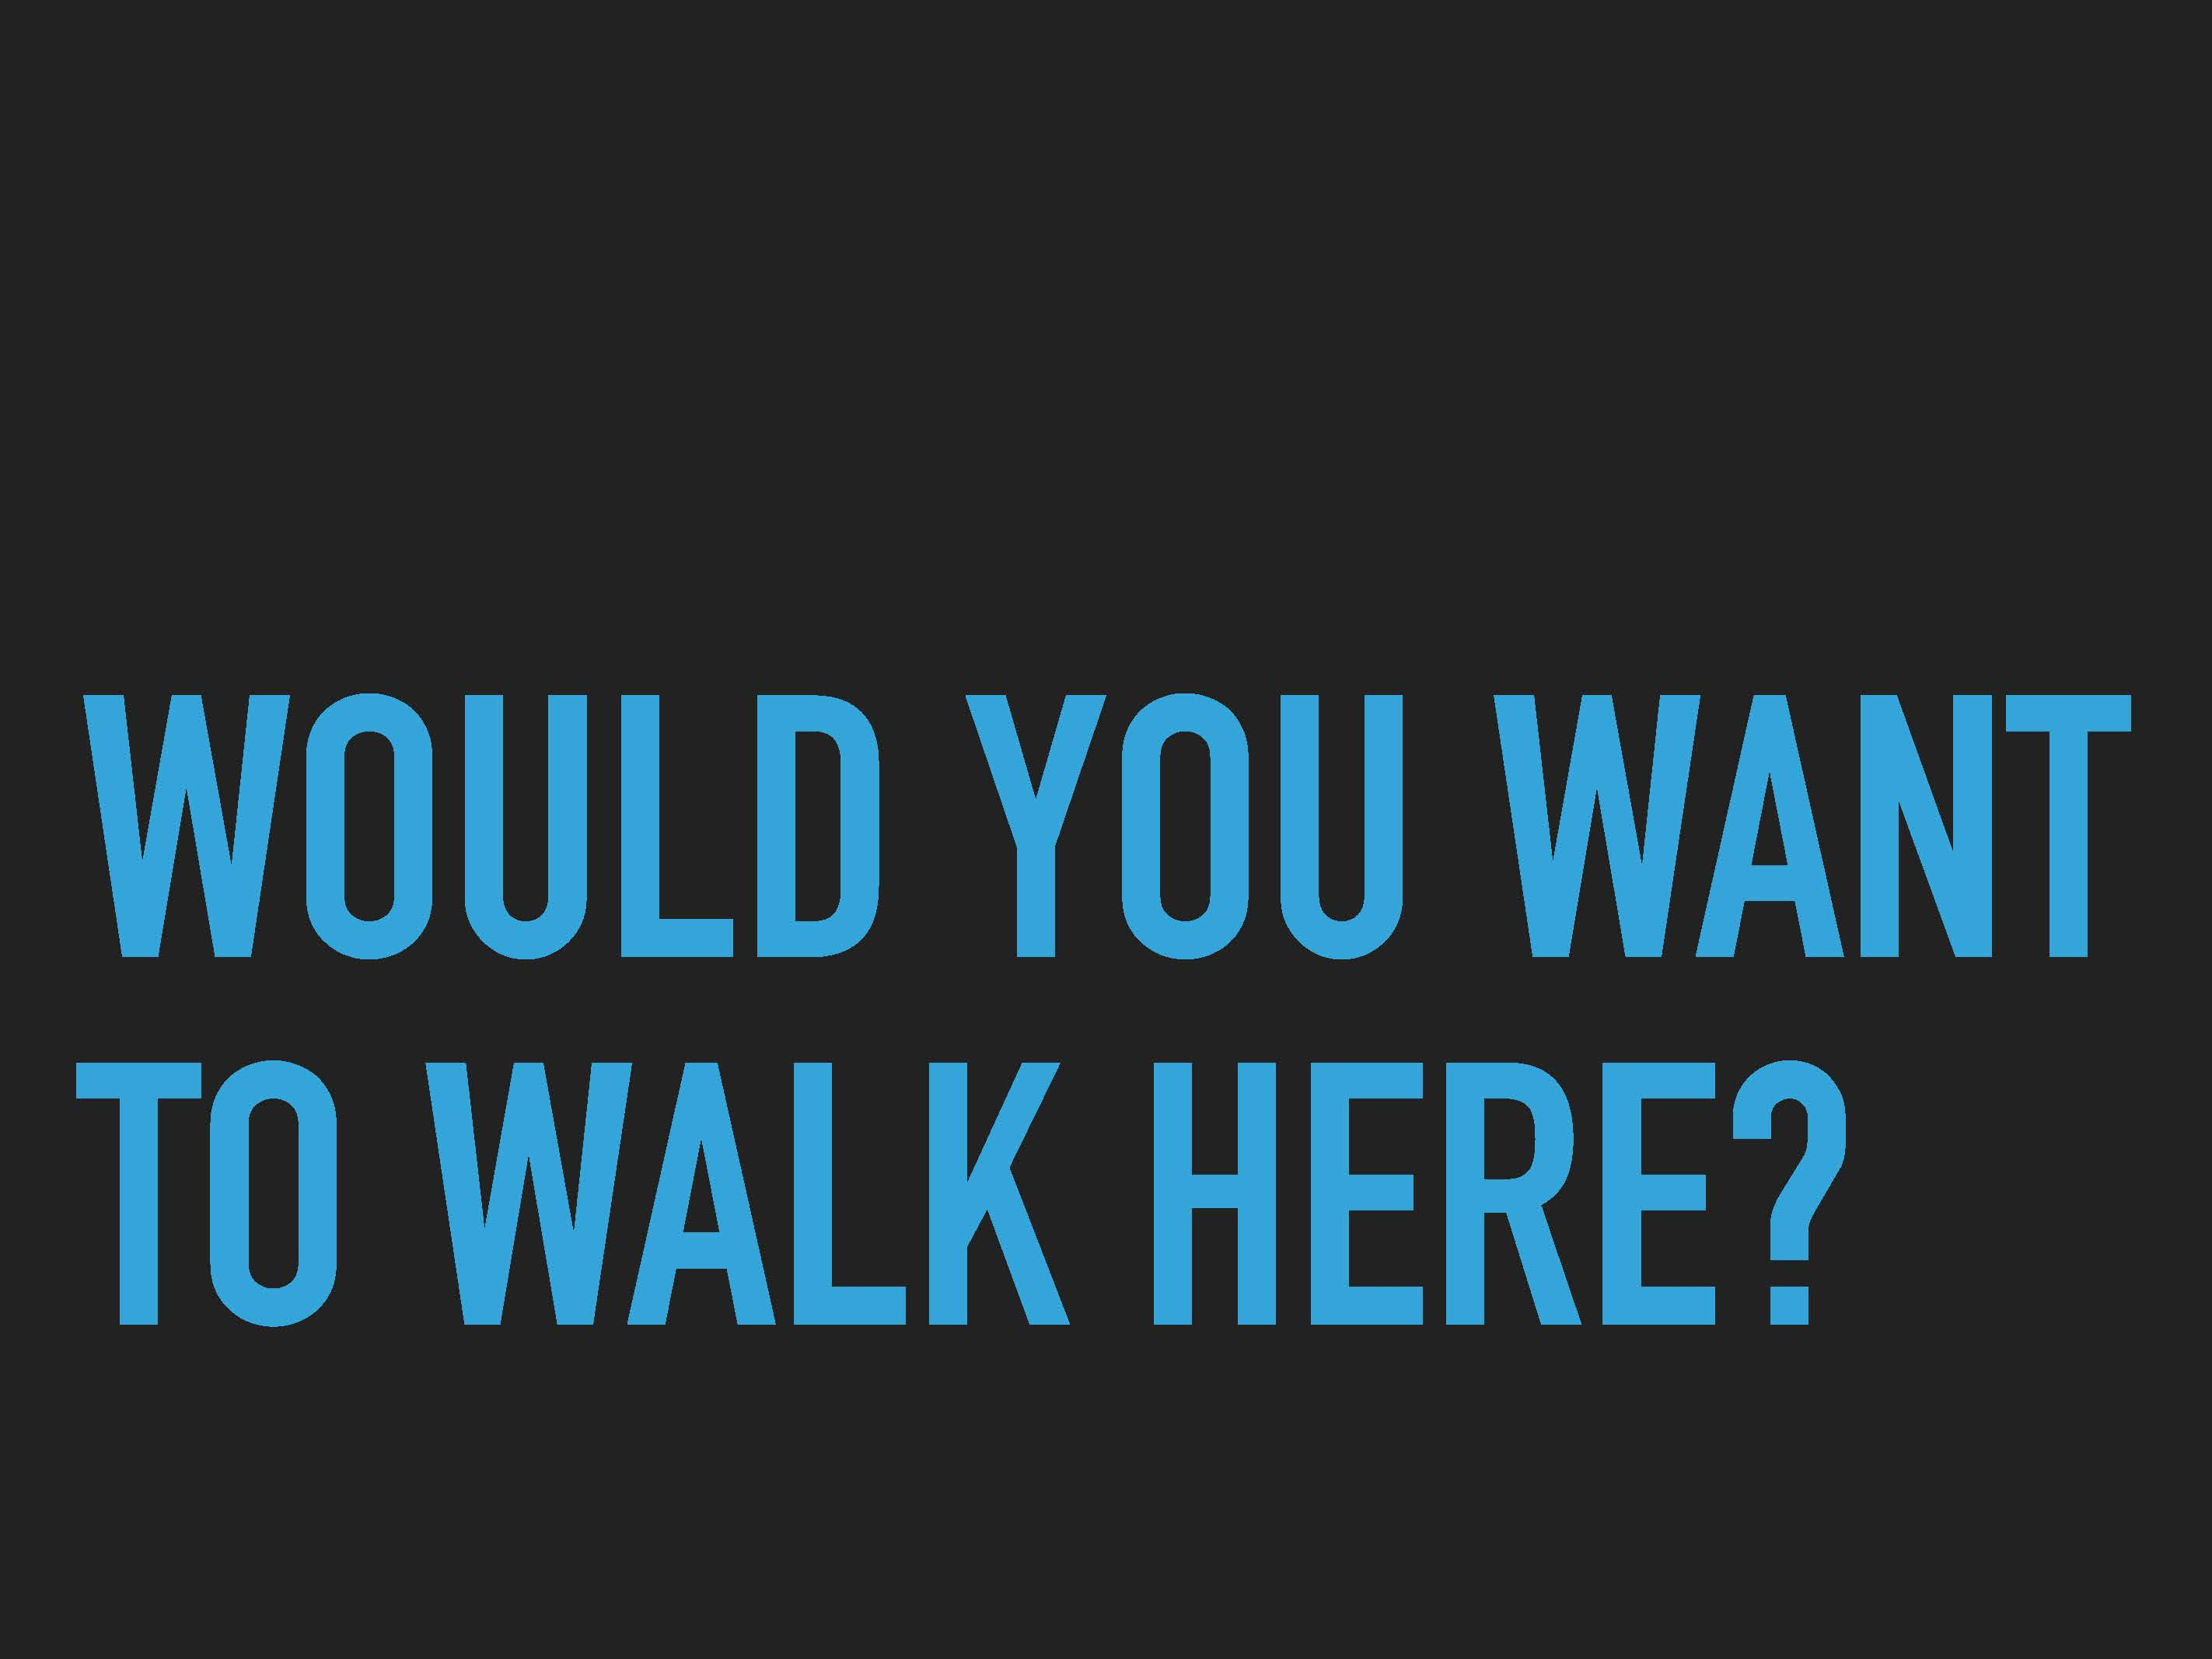

Slide 25
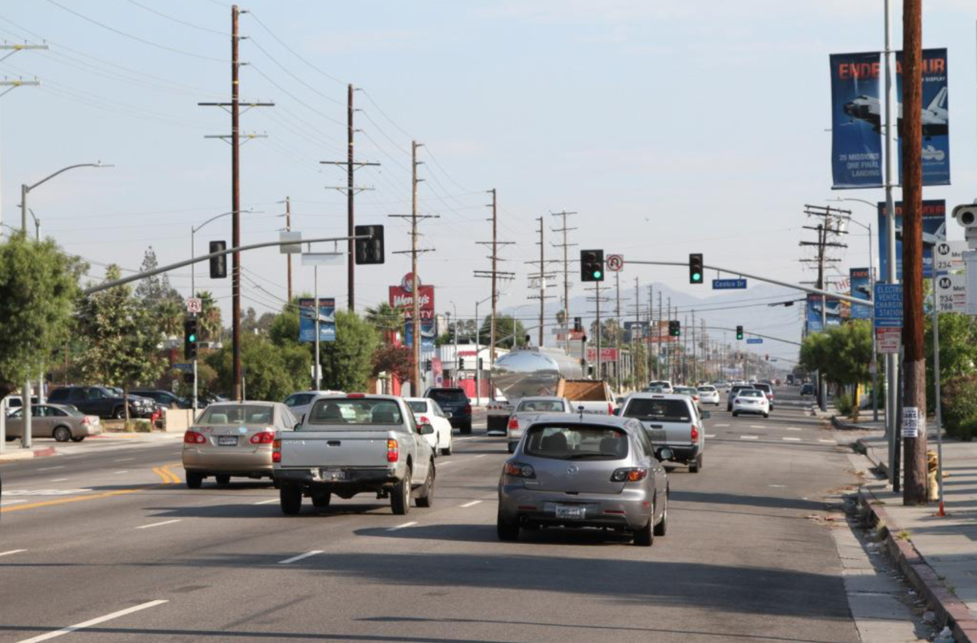

Slide 26
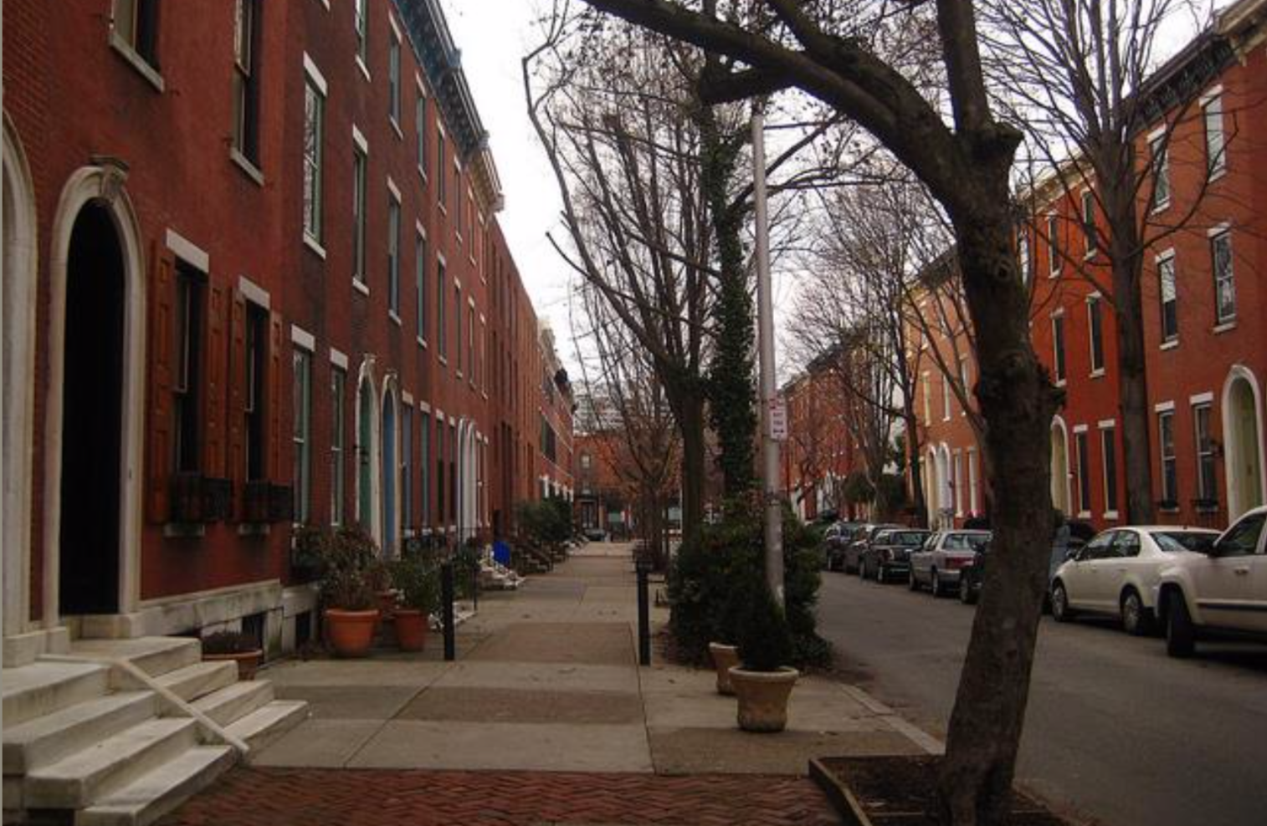

Slide 27
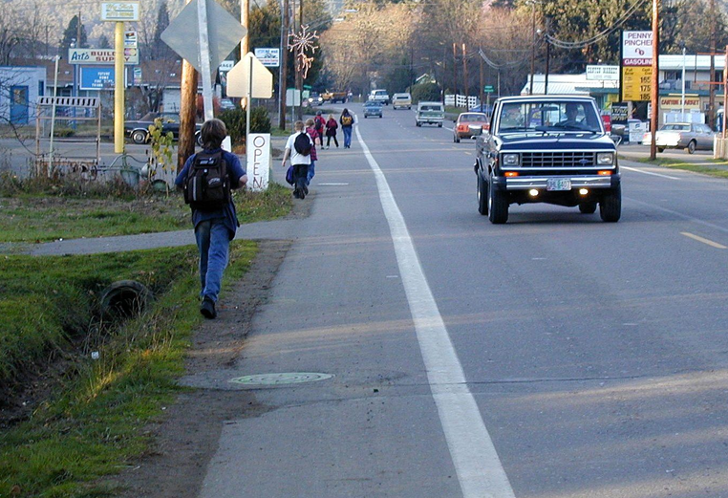

Slide 28
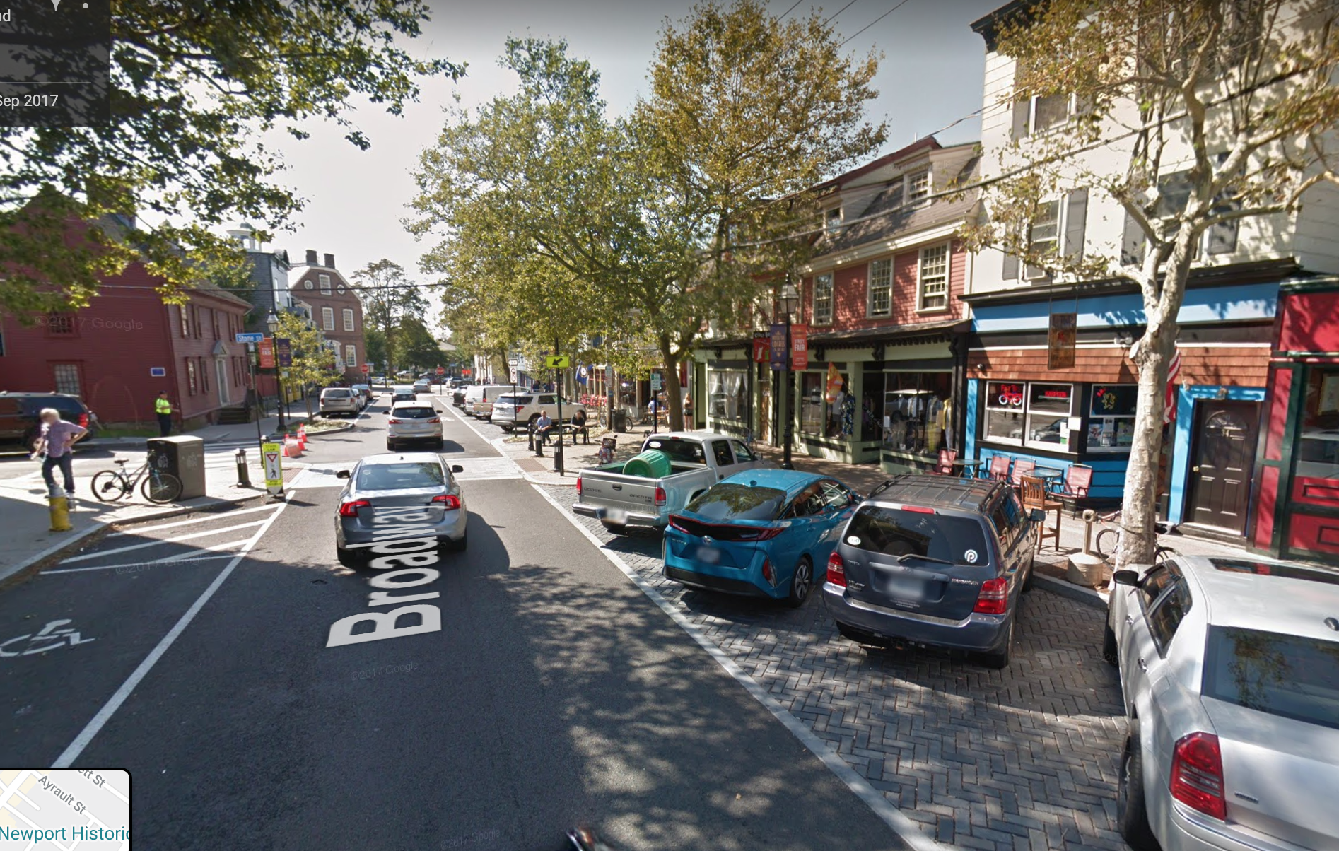

Slide 29
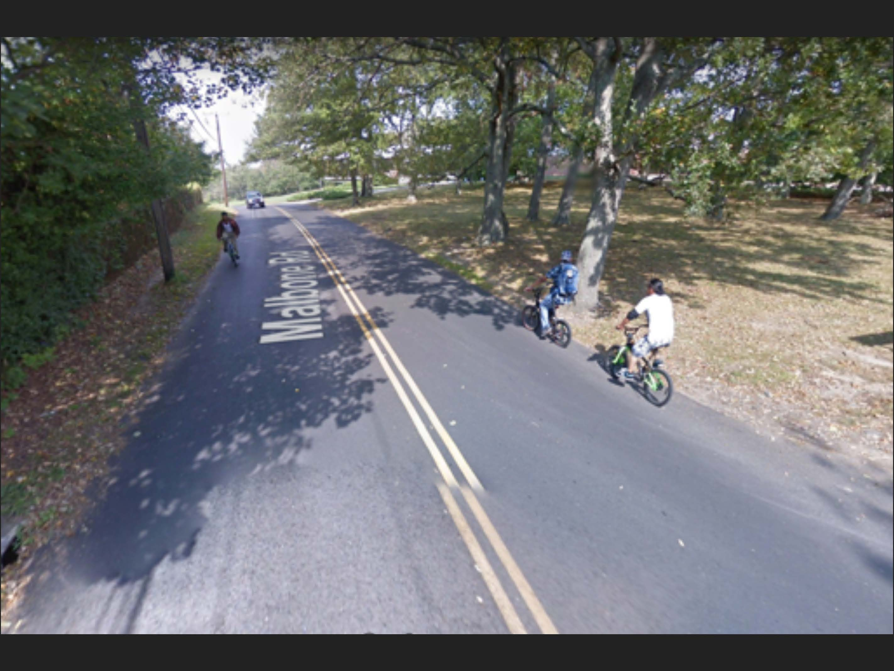

Slide 30
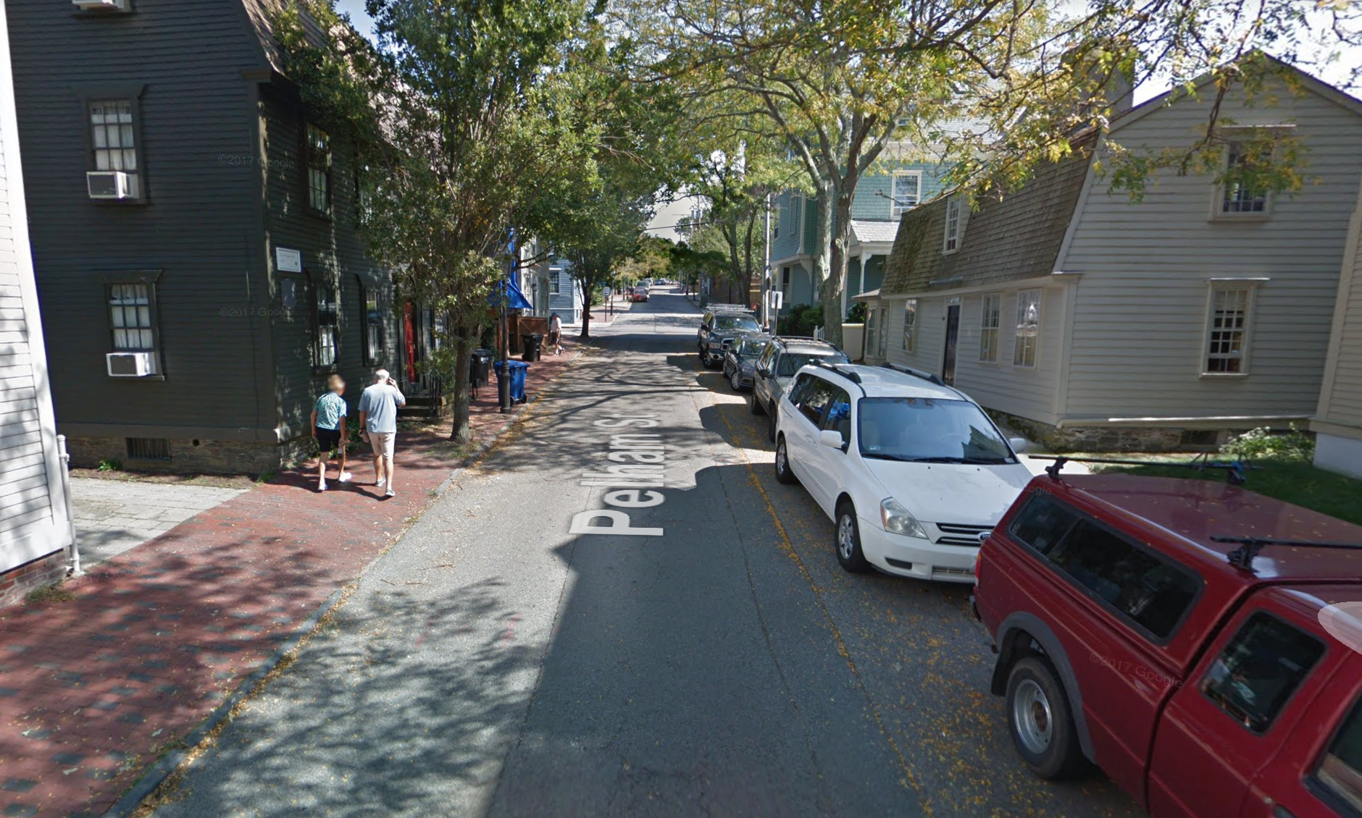

Slide 31
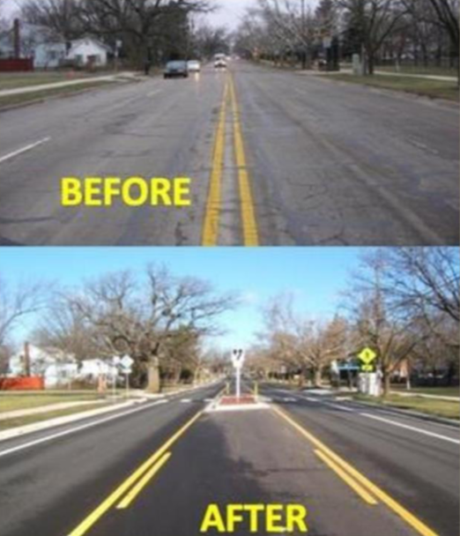

Slide 32
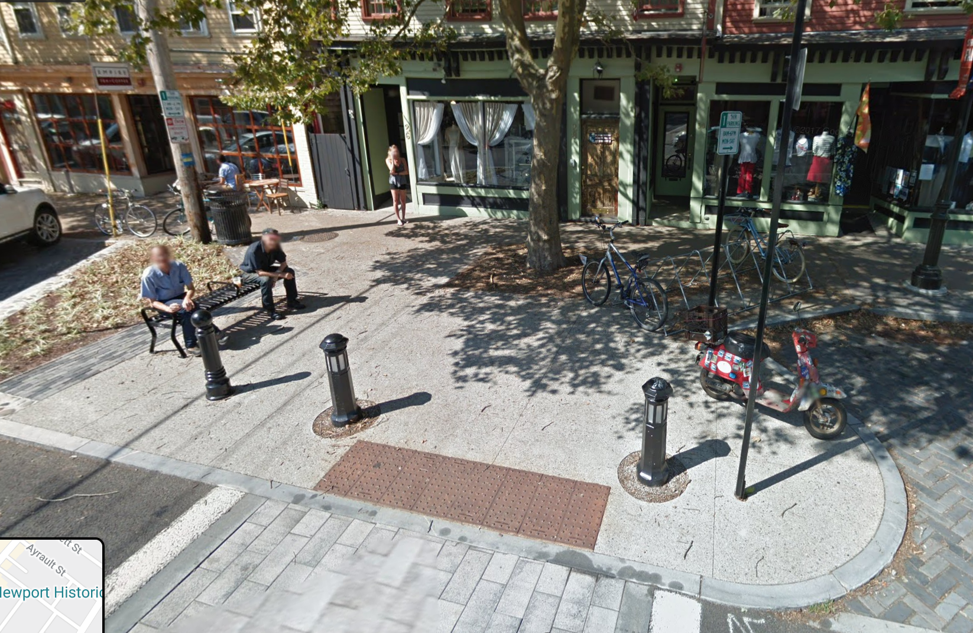
ELEMENTS OF COMPLETE STREETS:

Slide 33

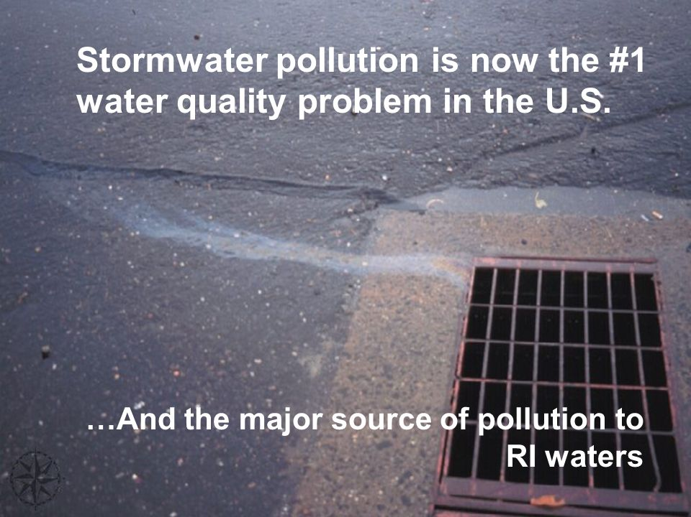

Slide 34
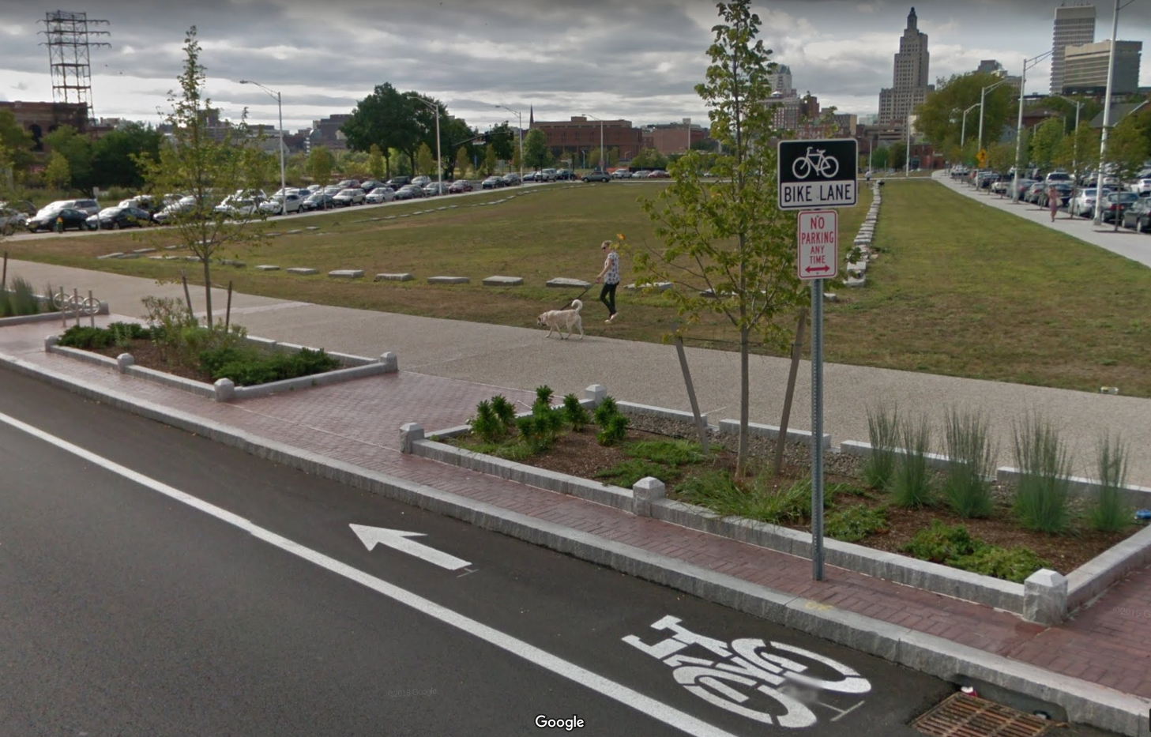
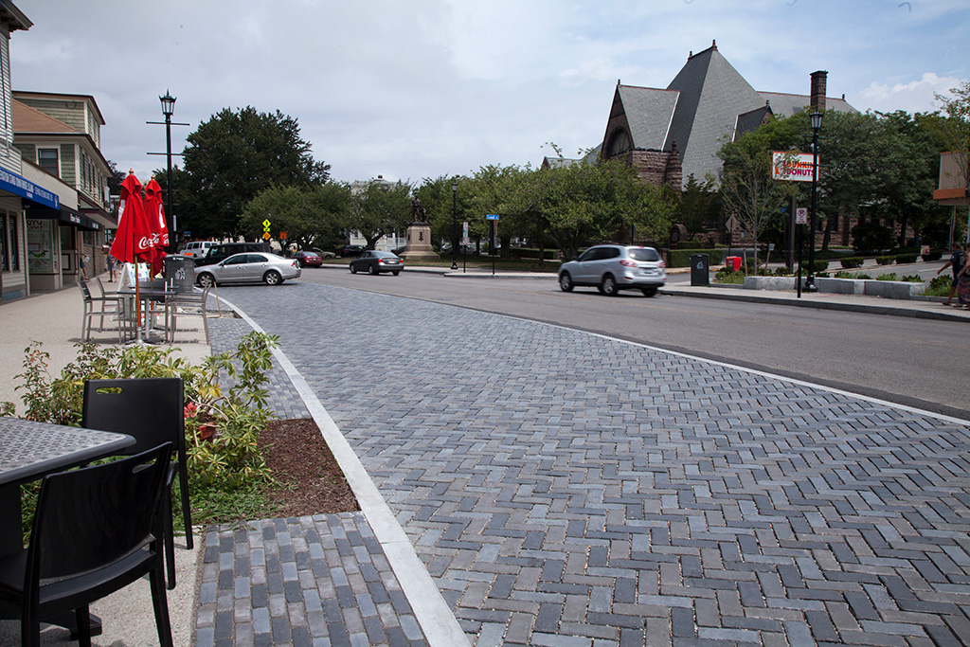
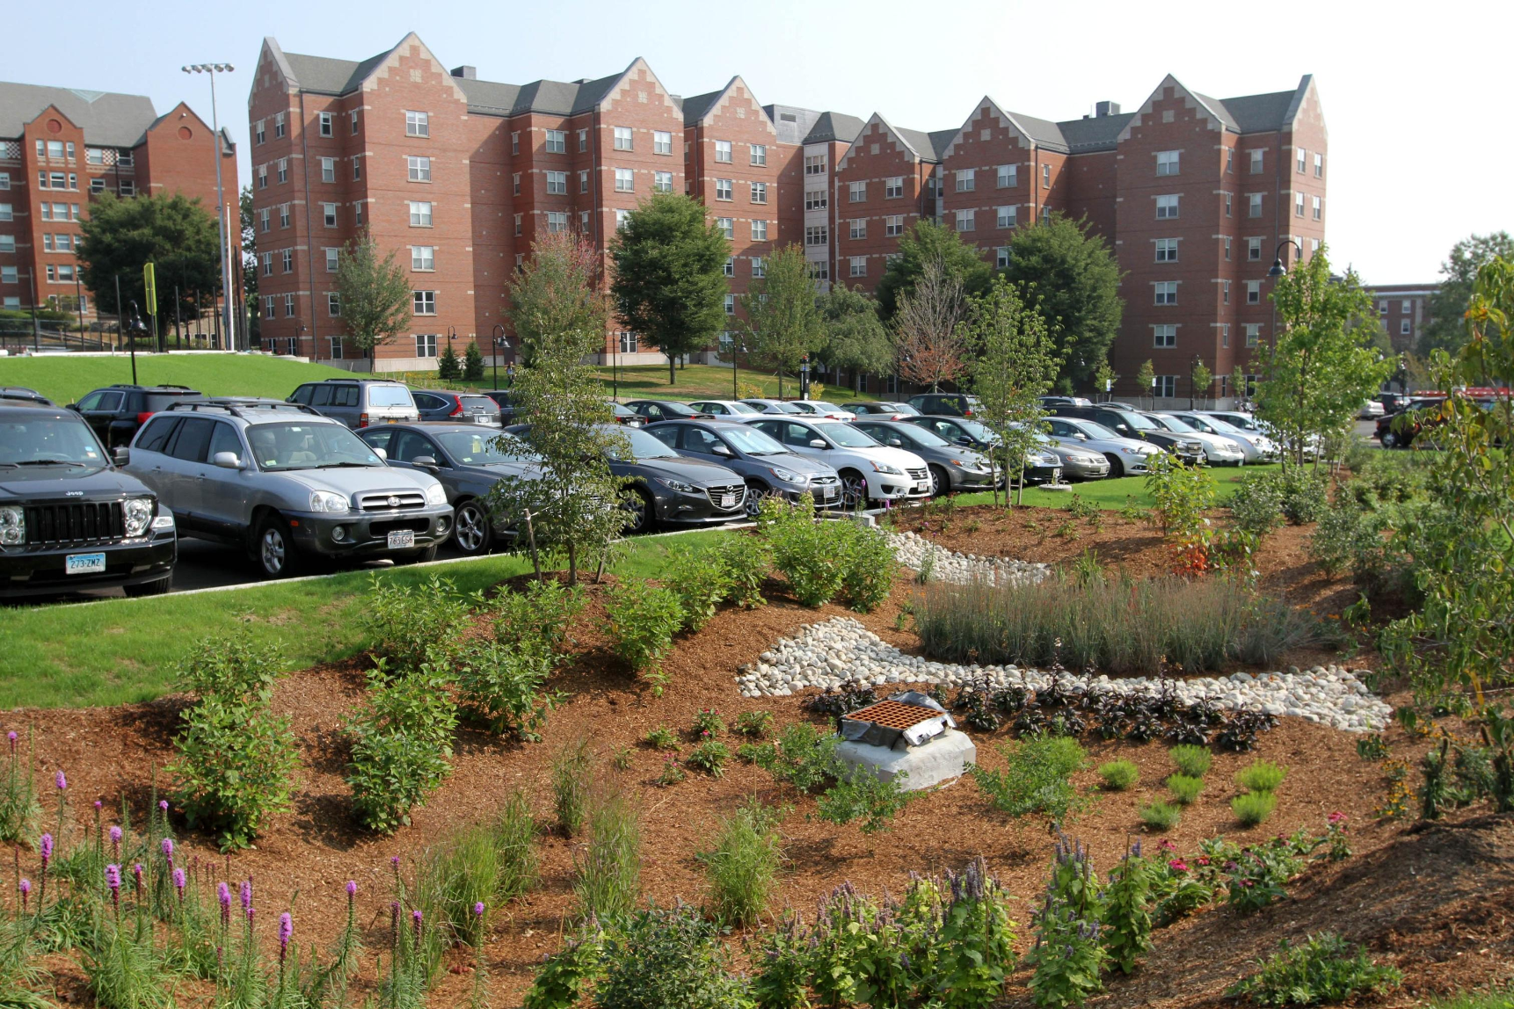
Green Streets:
Bio swales
Rain gardens
Pervious paving
Street trees

Slide 35
Green and Complete Streets Typologies
Narrower travel lanes
More striping
Street trees
Mode separation
Intense design and community engagement

Slide 36
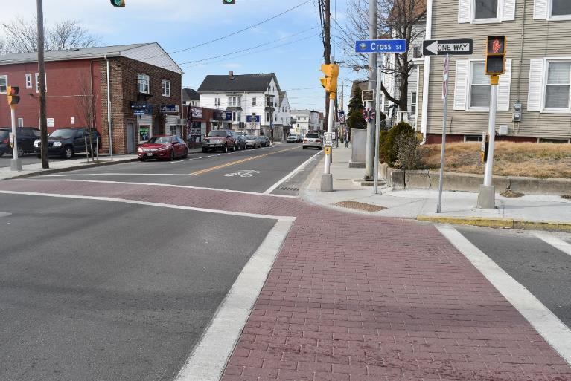
Main streets
36
Notes:
Photo: Dan Burden, Walkable and Livable Communities Institute, Hamburg, NY

Slide 37
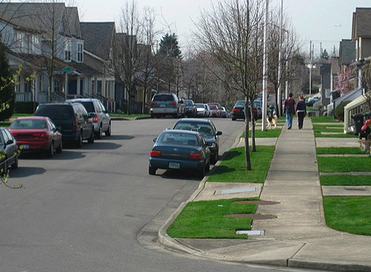
Residential streets with sidewalks
37

Slide 38
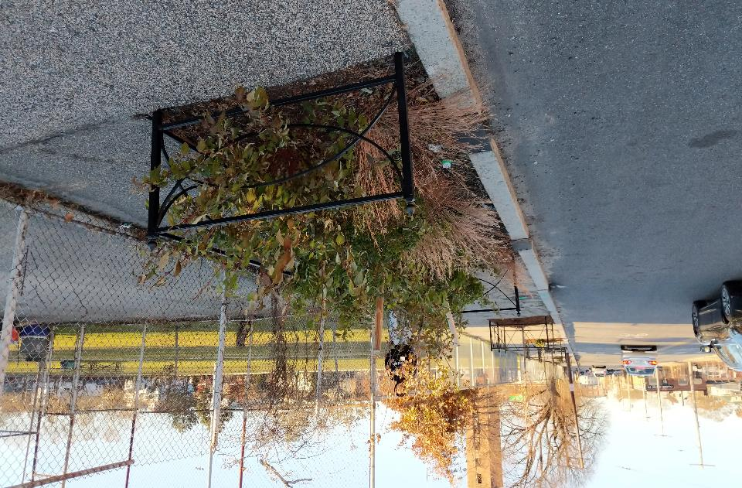
Tree boxes
Notes:
PROVIDE HABITAT FOR NATIVE SPECIES OF FLORA AND FAUNA

Slide 39
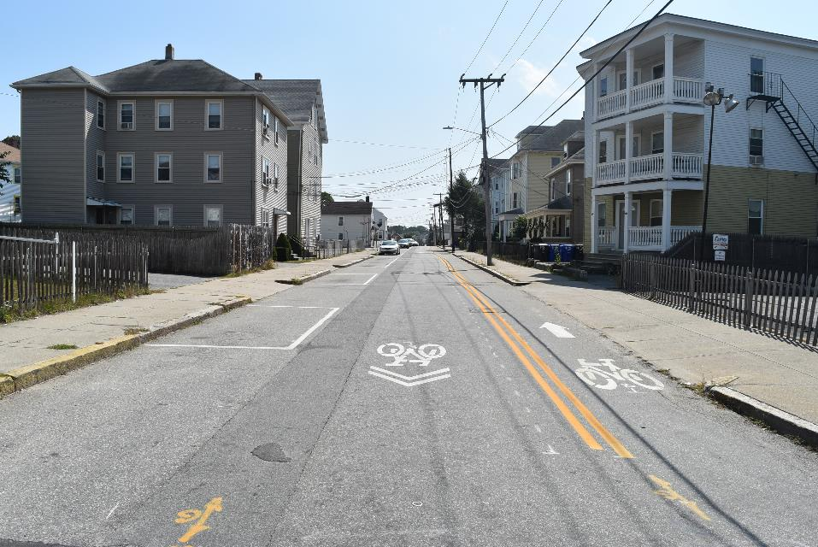
Contraflow bike lanes

Slide 40
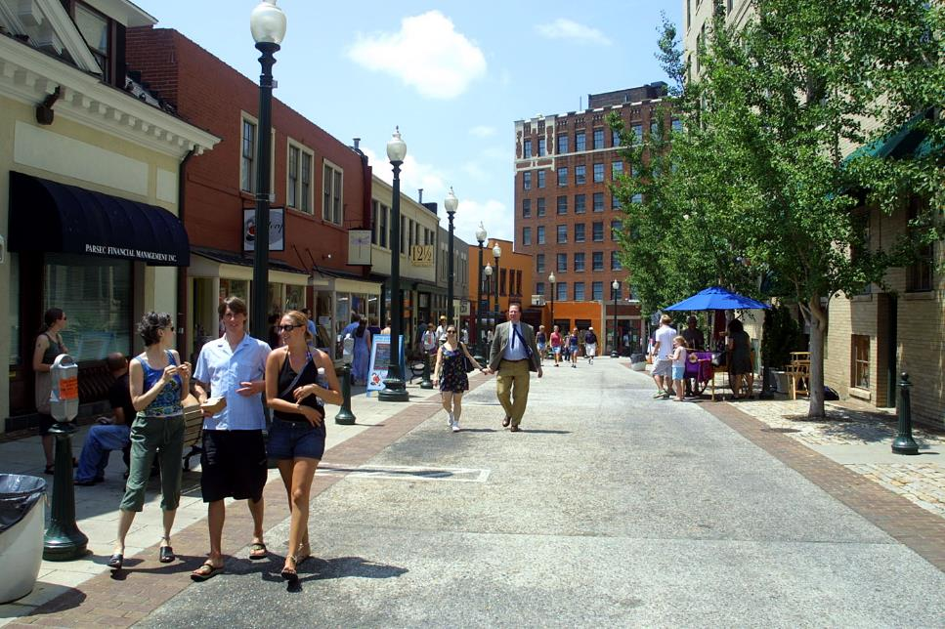
Shared commercial streets
40
Notes:
This is an example of a shared street in a more commercial setting with high numbers of people walking.

Slide 41
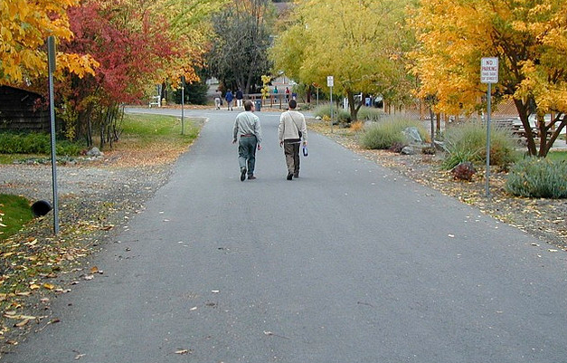
Low-traffic, low-speed skinny residential streets
41
Notes:
Shared streets are streets without sidewalks, crosswalks, or lane markings, essentially eliminating the distinction between cars, pedestrians, and people on bicycles. The idea is to let each user figure out how to safely navigate the street and share the right-of-way. This is an example of a shared street in a low-density, residential setting with low traffic volumes.

Slide 42
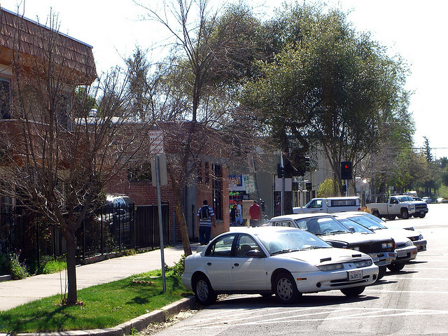
Angled head-out parking
Notes:
Angled head-out parking is on-street parking where drivers back into parking spaces, placing the rear of the car closest to the curb. This strategy improves safety for occupants of the car and for passing vehicles and bicyclists. Angled head-out parking provides drivers entering traffic with greater visibility, decreasing the likelihood of crashes. By changing the orientation of the car so the trunk is close to the curb, angled head-out parking improves safety for children getting out of the car and people loading items in their trunks. In the first four years of implementation in Tucson, AZ, treated segments went from 3-4 auto-bicycle crashes a month to no reported crashes. This type of parking benefits local economies because it uses less curb space per car than traditional parallel parking and is often used on main streets.
Sources: Nelson\Nygaard Consulting Associates: http://lda.ucdavis.edu/LDA191/Course%20Handouts%20%26%20Readings/05-Back_in_Diagonal_Parking.pdf
Photo by Eric Fredericks, neighborhoods.org

Slide 43
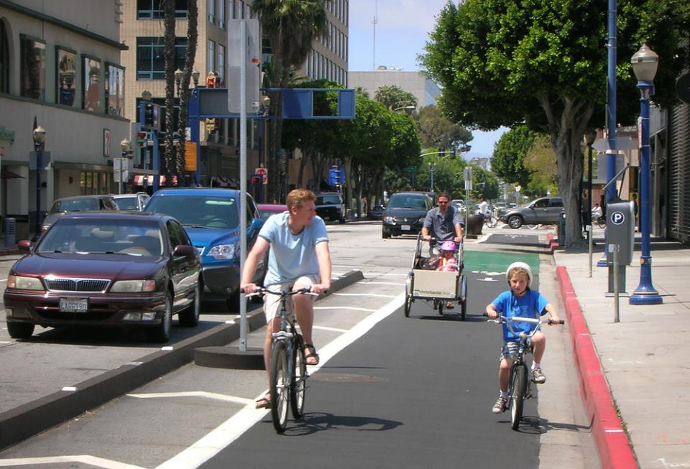
Protected bike lanes
Notes:
Cycle tracks are on-street bicycle facilities separated from vehicle travel lanes, parking lanes, and sidewalks by medians, bollards, and markings. Cycle tracks combine the user experience of a separated path with the on-street convenience of a conventional lane. In separating bicyclists from automobile traffic, cycle tracks can make bicyclists feel more comfortable and attract new bicyclists. They also clarify expected behavior for bicyclists and automobiles, decreasing the risk of bicyclists being hit by open car doors. Cycle tracks are growing in popularity in North America and can be found in cities such as Cambridge, MA; New York City, Portland, OR; and Washington, D.C. In Montreal, streets with this treatment have 2.5 as many bicyclists and 28 percent lower injury rates than streets without cycle tracks.
Sources: Bicyclinginfo.org http://www.bicyclinginfo.org/faqs/answer.cfm?id=3962; NACTO Urban Bikeway Design Guide, http://nacto.org/cities-for-cycling/design-guide/cycle-tracks/; Lusk, C., Furth, P., et al. (2011). Risk of injury for bicycling on cycle tracks versus the street. (2011). http://injuryprevention.bmj.com/content/early/2011/02/02/ip.2010.028696.full.pdf;
Photo: http://orange20bikes.com/uploads/blogimages/2011/04/LBC_cycletrack_02.jpg photo by Orange Bikes, Long Beach, CA

Slide 44
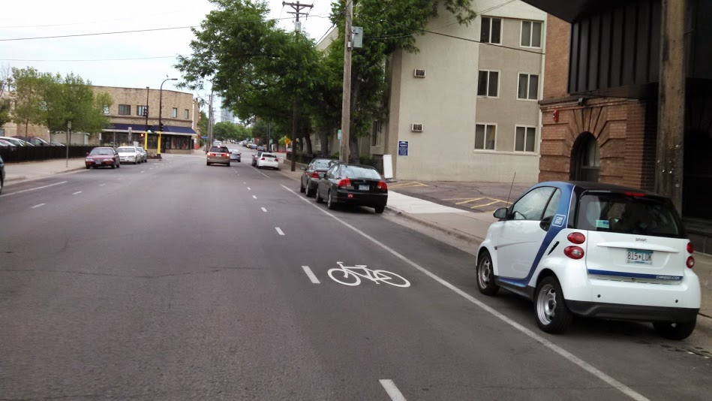
Advisory bicycle lanes
Notes:
Advisory bicycle lanes are bicycle lanes that cars and trucks can legally use if there are no people riding on bicycles. They are also known as a “non-compulsory bicycle lane” or a “suggestion lane” and are common in the Netherlands and the U.K. They have been applied in Minneapolis, Portland and New Hampshire. Advisory bicycle lanes are characterized by dashed lane demarcation, and in tandem with the removal of a centerline on streets. They are useful on streets that are too narrow for mandatory bicycle lanes, and on streets that see high bicycle volume and vehicle traffic that is above the average residential street, but still low. Parking should be blocked from the lane.
Source: APBP, Streetsblog
Photo: Peter Koonce, Minneapolis, MN

Slide 45
Green and Complete Streets is not:
One “special” street project
A design prescription
A mandate for immediate retrofit
A silver bullet; other issues must be addressed:
  Land use (proximity, mixed-use)
  Other environmental concerns
  Transportation Demand Management
Notes:
Complete Streets is not about special projects. It’s about changing the way we approach transportation projects on all streets.
It’s not about specific design elements. Implementation of Complete Streets is flexible and context-sensitive.
Adopting a policy doesn’t mean all roads have to be changed all at once. Changes can be made a little at a time and done along with routine maintenance.
Complete Streets won’t address all concerns, which will still need attention. Complete Streets policies are one important piece in ensuring our states are fiscally and physically healthy.

