Slide 1
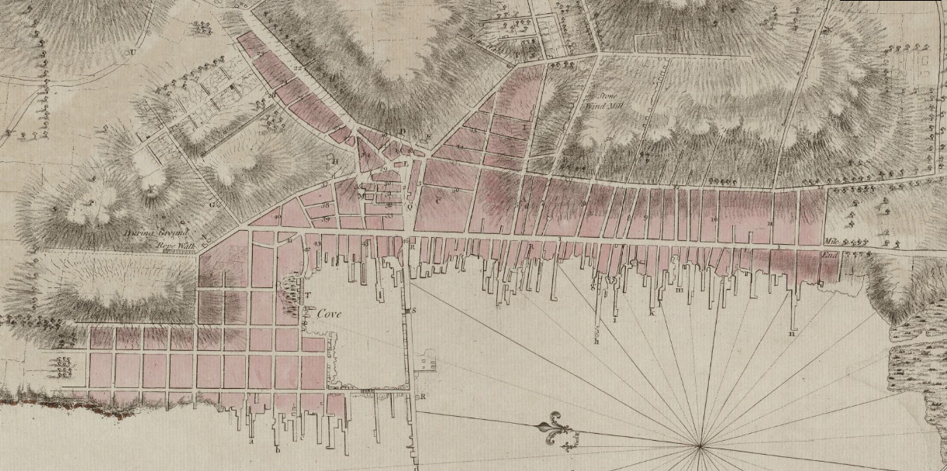
Information on Historic Properties
To better inform Planning Board Demolition Approval

Slide 2
“The City of Newport is committed to preserving the historically and culturally significant built environment and neighborhood architectural identities.
The demolition of structures in an historic and culturally significant city may damage the physical fabric and architectural context of the community. Therefore, a demolition permit is required prior to the demolition of any principal structure beyond the established border of the local historic district.
Prior to the issuance of a demolition permit for any principal structure, the planning board must approve any demolition of a principal structure.”
Codified Ordinances of the City of Newport, Rhode Island, Chapter 17.86- Demolition of Structures
Notes:
https://library.municode.com/ri/newport/codes/code_of_ordinances?nodeId=COOR_TIT17ZO_CH17.86DEST

Slide 3
Historic District Commission reviews demolition applications within the Local Historic District
Newport’s Standards for Treatments of Historic Properties (17.80.060) guide this review process

Slide 4
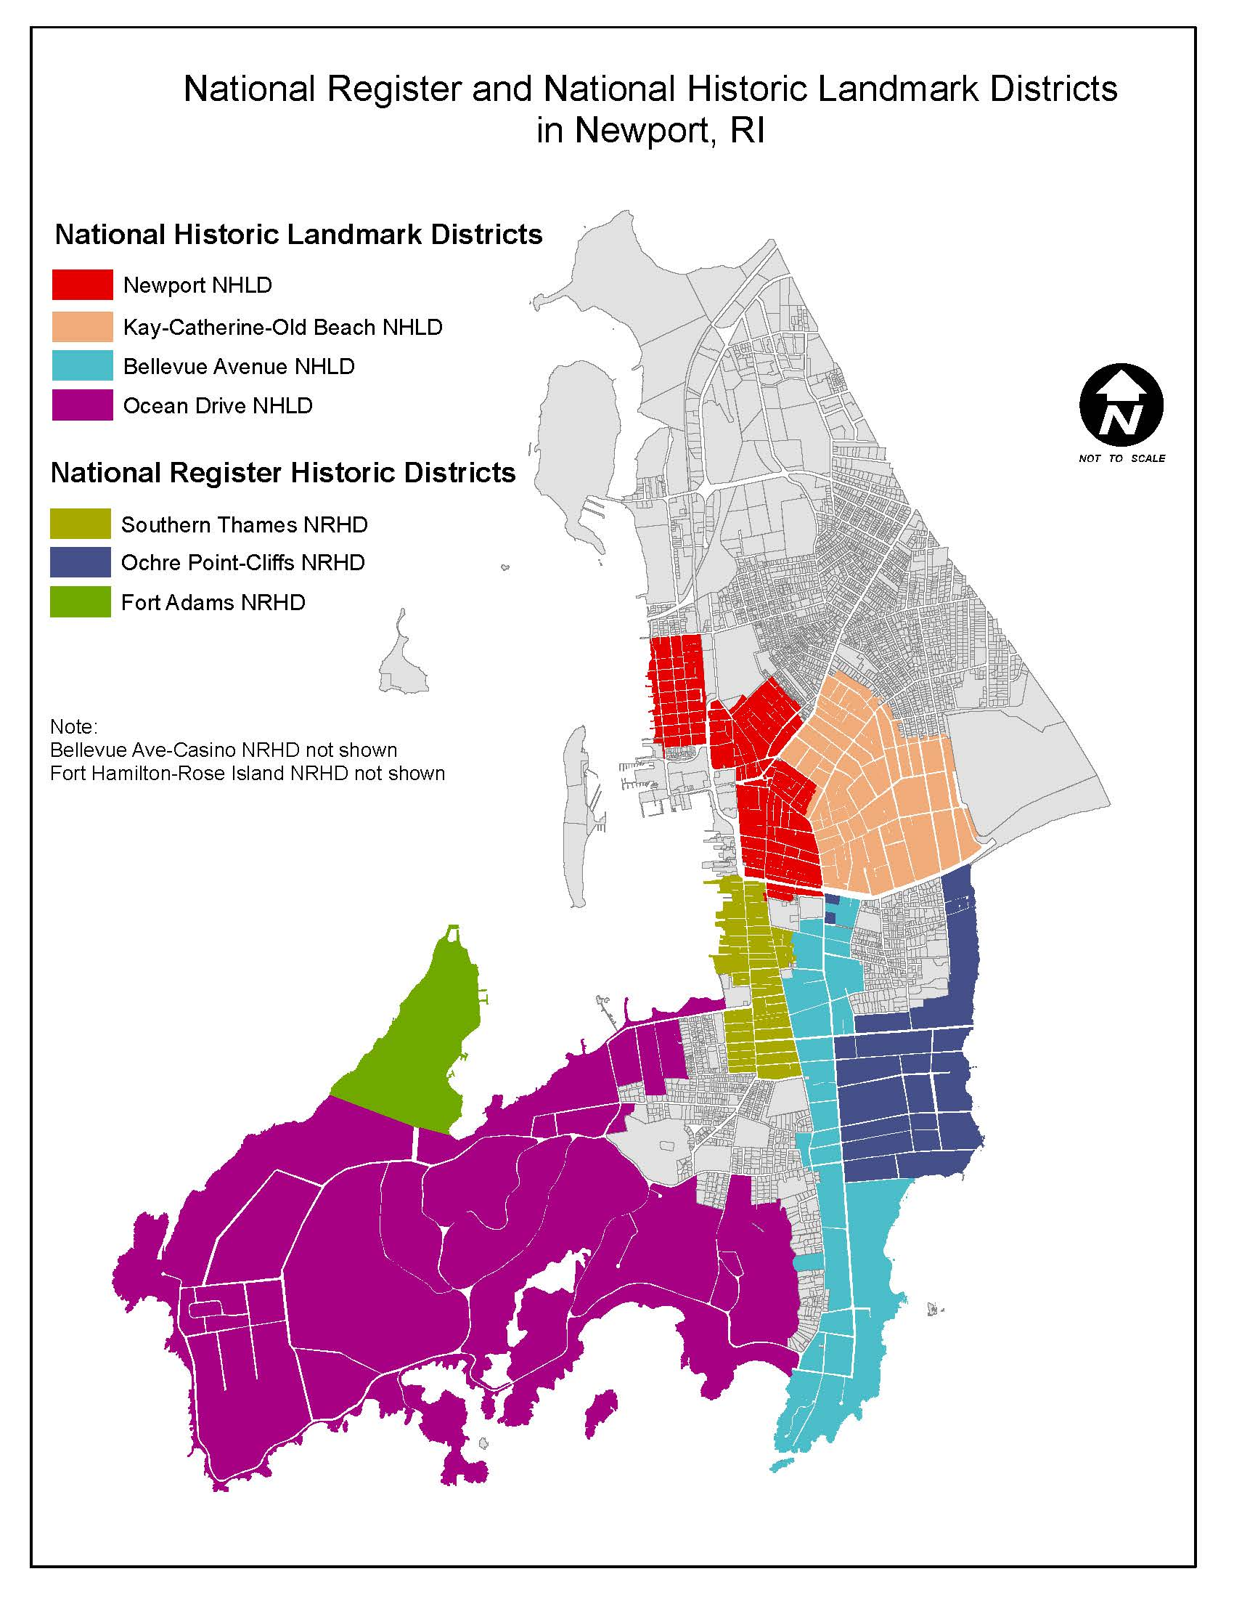
Planning Board reviews demolitions outside the local historic district
The Comprehensive Plan guides this review process

Slide 5
National Register of Historic Places
The National Register of Historic Places is the official list of the Nation's historic places worthy of preservation
Authorized by the National Historic Preservation Act of 1966
Part of a national program to coordinate and support public and private efforts to identify, evaluate, and protect America's historic and archeological resources.
Includes buildings, structures, sites, objects and districts. Individual structures are listed on the National Register, but entire neighborhoods or areas can also be designated as a National Historic District.
Notes:
https://www.nps.gov/subjects/nationalregister/what-is-the-national-register.htm
https://californiapreservation.org/ufaqs/what-is-the-difference-between-the-national-register-of-historic-places-a-national-historic-district-and-a-national-historic-landmark/

Slide 6
National Register Historic District/Individual Listing
Newport’s National Register Historic Districts
Kay-Catherine-Old Beach Road
Bellevue Avenue-Casino Historic District
Ochre Point-Cliffs
Southern Thames
Fort Hamilton-Rose Island
A National Register Historic District is a district important in American history at the national level of significance and is listed on the National Register. To qualify, the area must retain architectural integrity and reflect an aspect of the area’s history. A historical overview of the entire district is needed. The purpose of the overview is to provide a basic background history of the area and to justify the significance of the district.
Notes:
https://californiapreservation.org/ufaqs/what-is-the-difference-between-the-national-register-of-historic-places-a-national-historic-district-and-a-national-historic-landmark/

Slide 7
National Historic Landmark District/Individual Listing
The highest level of designation is a National Historic Landmark. Landmarks are properties deemed significant to all Americans because of their exceptional values or qualities, which help illustrate or interpret the heritage of the United States.
Newport’s National Historic Landmark Districts
Newport National Historic Landmark District
Bellevue Avenue National Historic Landmark District
Ocean Drive National Historic Landmark District
Fort Adams National Historic Landmark District
Designated by the Secretary of the Interior, National Historic Landmarks are a select group of National Register listed districts/properties that rise to national importance due to their exceptional ability to illustrate or interpret American heritage.
Notes:
https://californiapreservation.org/ufaqs/what-is-the-difference-between-the-national-register-of-historic-places-a-national-historic-district-and-a-national-historic-landmark/

Slide 8
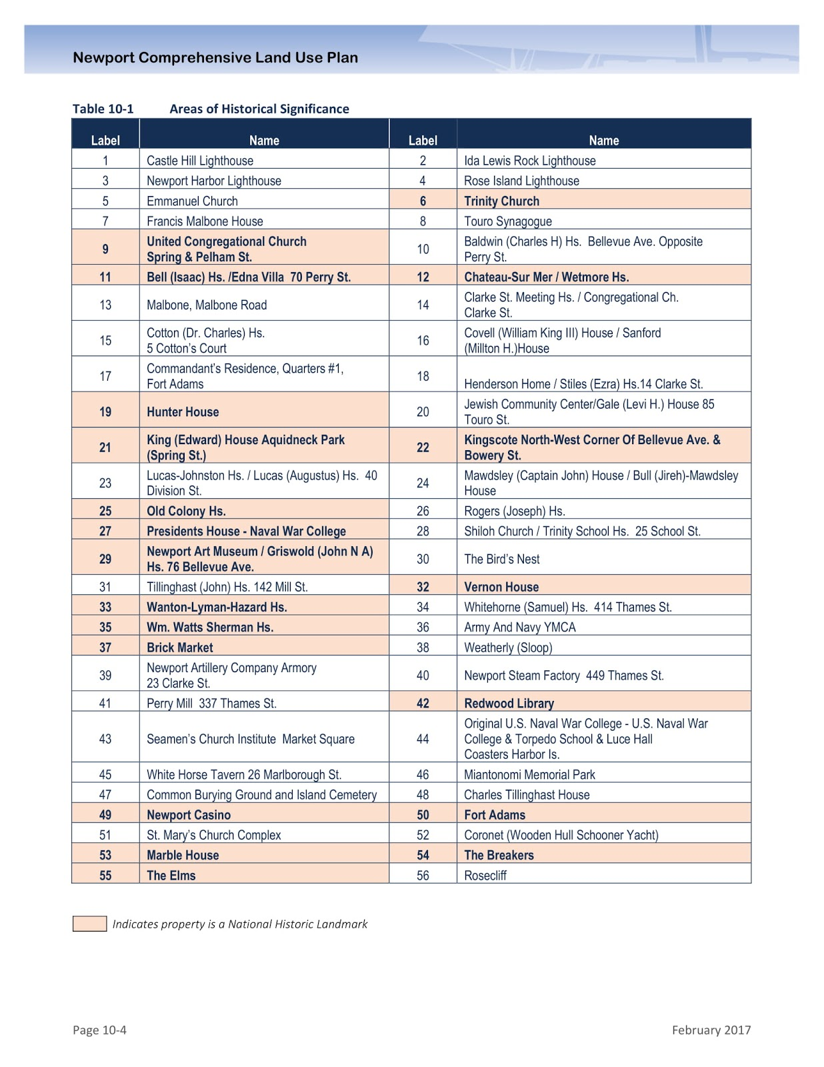
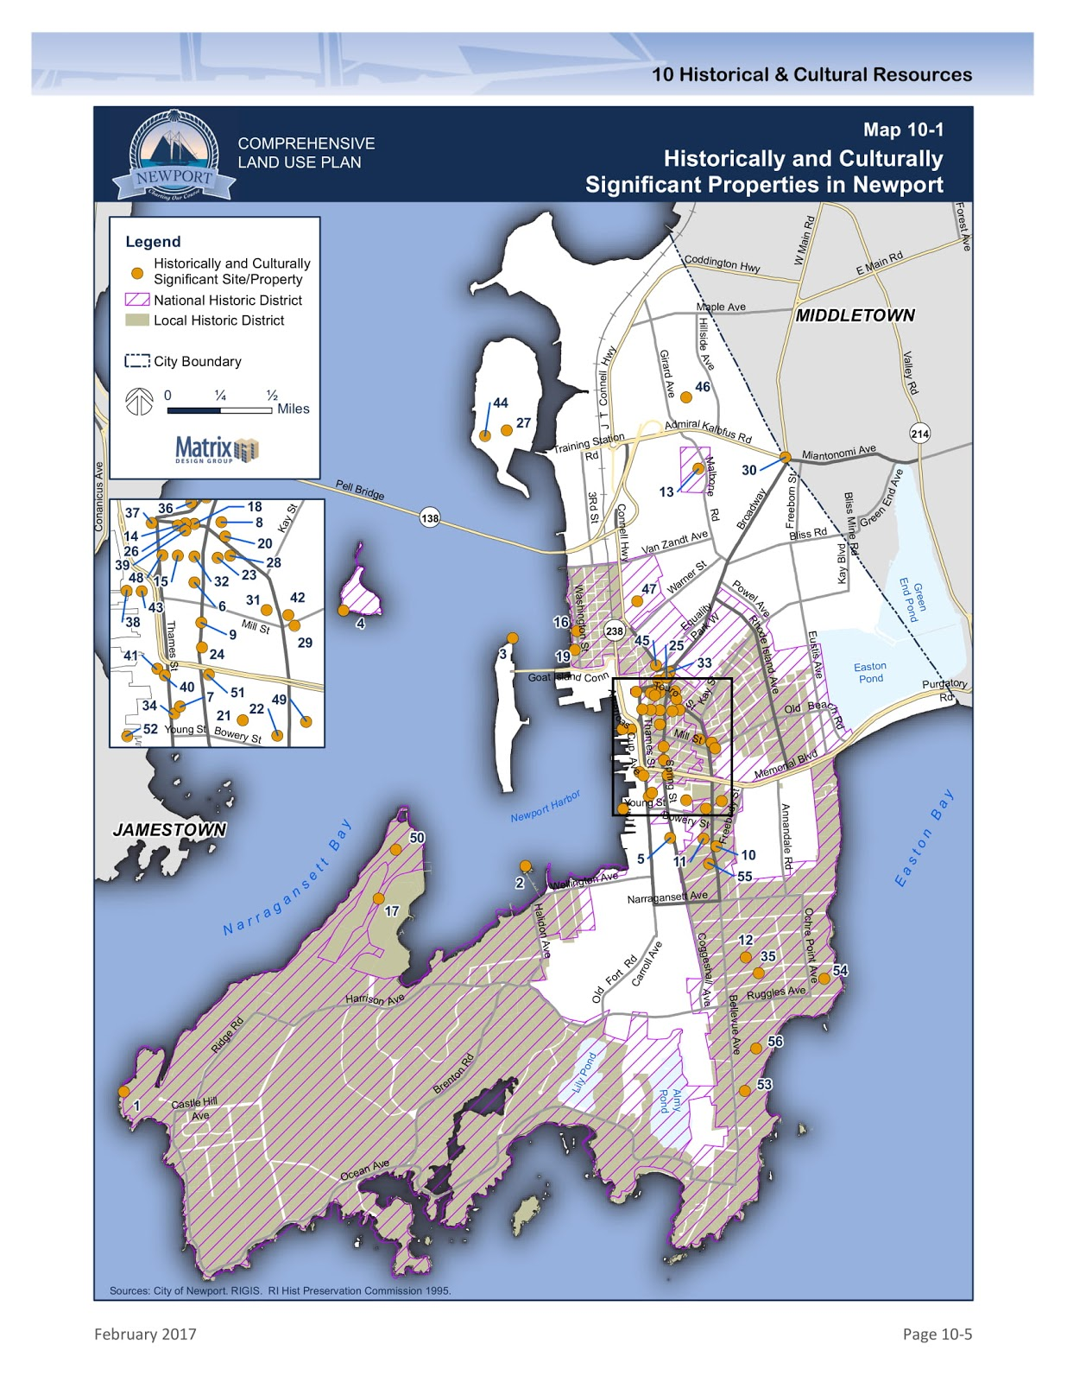
Notes:
https://www.nps.gov/subjects/nationalregister/upload/national-historic-landmarks-20181017.xlsx

Slide 9
Criteria considered when nominating districts/buildings/sites/structures/objects
A. That are associated with events that have made a significant contribution to the broad patterns of our history
B. That are associated with the lives of persons significant in our past
C. That embody the distinctive characteristics of a type, period, or method of construction, or that represent the work of a master, or that possess high artistic values, or that represent a significant and distinguishable entity whose components may lack individual distinction
D. That have yielded, or may be likely to yield, information important in prehistory or history.

Slide 10
National Register Districts and National Historic Landmark Districts are composed of contributing and non-contributing buildings

Slide 11
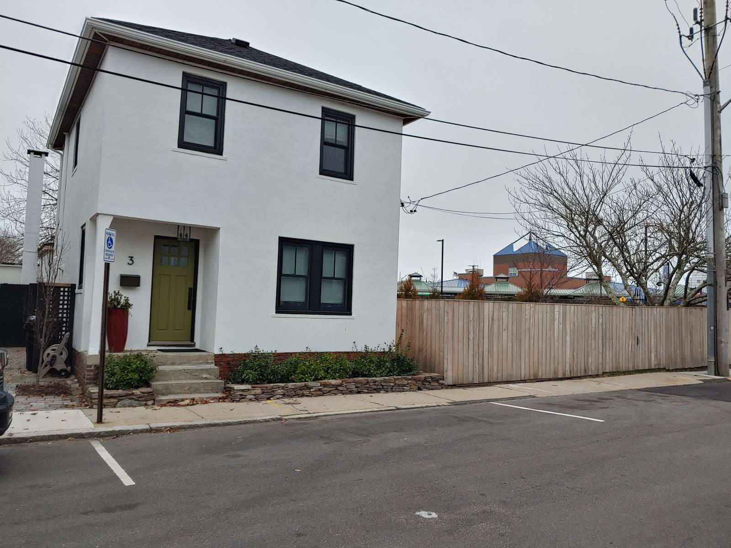
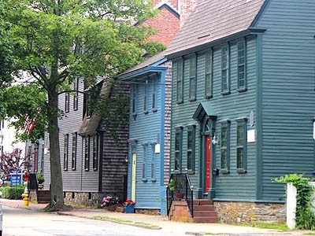
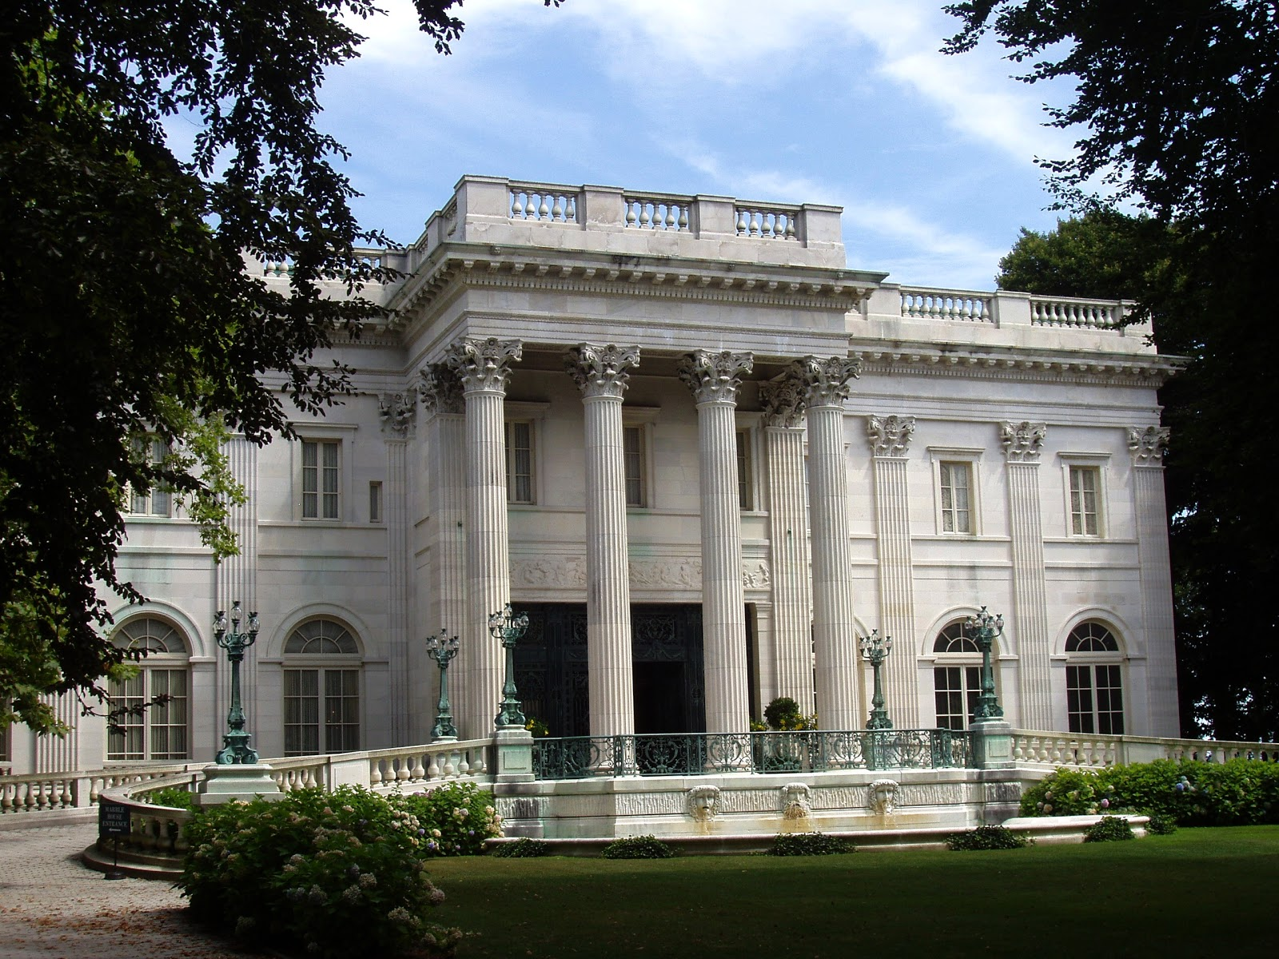
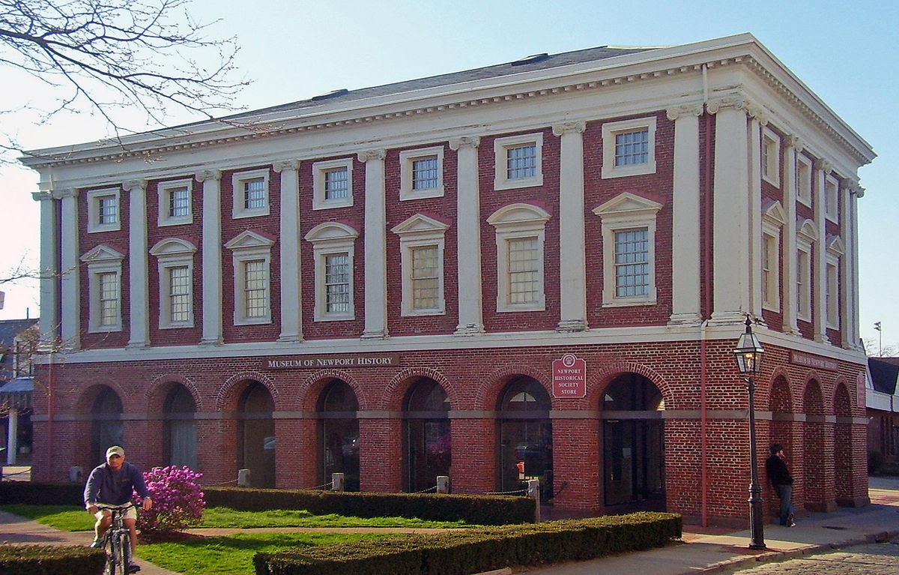
Contributing Building
Meets at least one of the 4 criteria and falls within the district’s statement of significance and/or constructed within period of significance

Slide 12
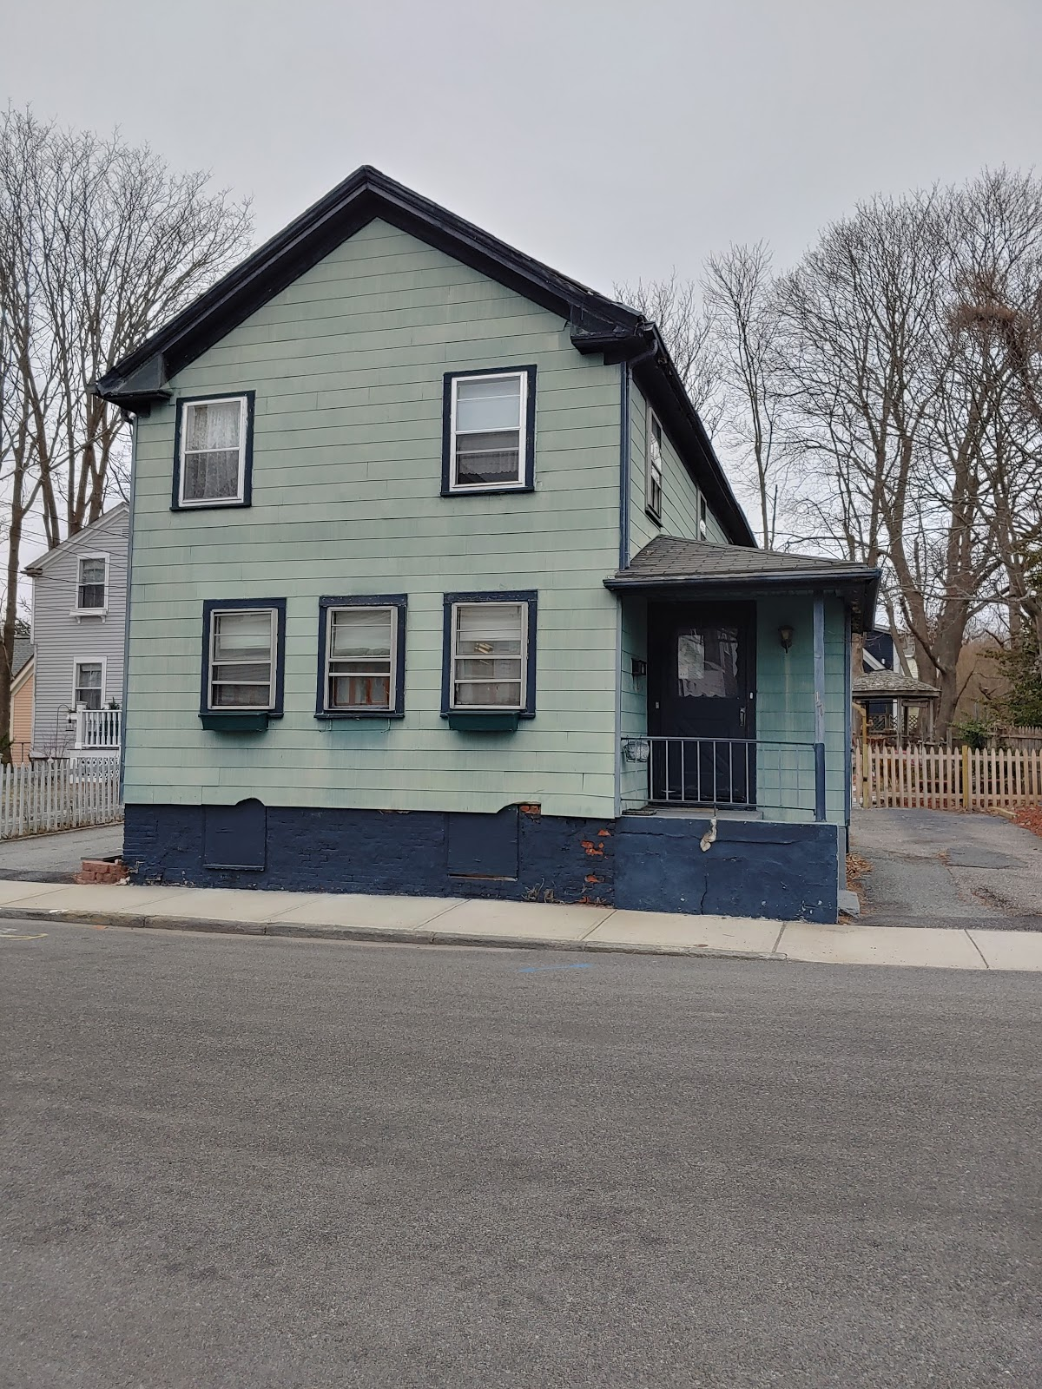
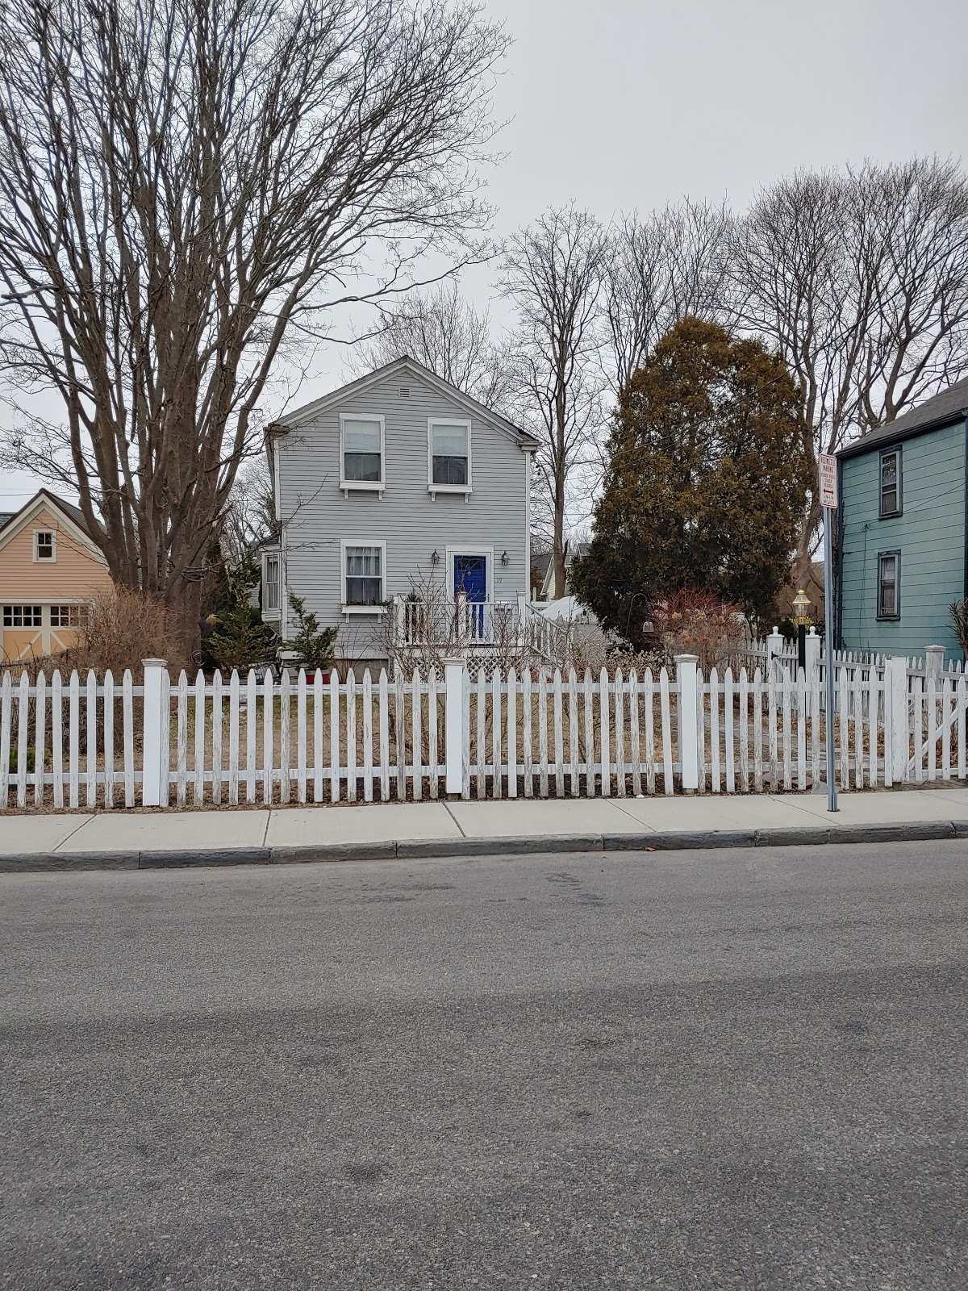
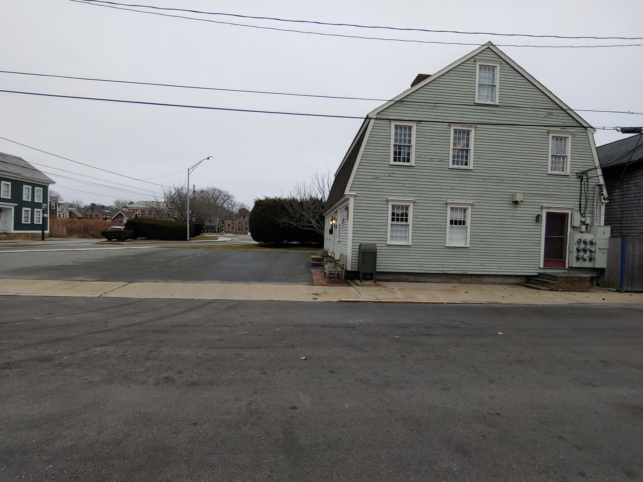
Non-Contributing Building
Does not contribute to the statement of significance and/or was not constructed during period of significance

Slide 13
Planning for Historic Properties

Slide 14
Planning Board Demolition Approval Required Findings
The granting of a permit is not detrimental to the public health, safety, and general welfare of the community.
The proposed demolition of the structure is consistent with the goals and policies of the Comprehensive Plan.
The proposed demolition does not create land with constraints to development.
The proposed demolition does no harm to the character of the immediate neighborhood or area of the city.
Newport Code of Ordinances. Section 17.86.070

Slide 15
Consistency with the Comprehensive Plan
Consistency with the Comprehensive Plan is a common planning concern. It is a requirement for Development Plan Review, variances, and subdivisions. The reviewing body should weigh all relevant aspects of the Comprehensive Plan, assigning weight to the matter at hand consistent with the intent of the Comprehensive Plan language, the intent of the review, and the type of proposed development. Zoning ordinances may be overturned by the RI Superior Court if they are found inconsistent with the Comprehensive Plan.
Cultural and Historic resources are a required component of a Comprehensive Plan in Rhode Island.
RIGL 45-22.2-6

Slide 16
Consistent with the State Guide Plan
Every comprehensive plan must be consistent with … the State Guide Plan and the laws of the State.
The Rhode Island Comprehensive Planning Standards Guidance Handbook Series. Guidance Handbook #4: Planning for Historic and Cultural Resources. Section 1. General Information on Planning for Historic and Cultural Resources p. 2
Notes:
http://www.planning.ri.gov/documents/comp_handbook/4_HistoricCultural.pdf

Slide 17
State Guide Plan
Preserve historic buildings, districts, and archaeological sites.
Land Use 2025: Rhode Island’s State Land Use Policies and Plan, LUP 24, page 2-10
Excellence in community design: communities that are high quality, energy efficient, safe, healthful, distinct, diverse, and aesthetically pleasing; communities that are rich in natural, historical, cultural, & recreational resources; communities that provide abundant economic opportunities.
Land Use 2025: Rhode Island’s State Land Use Policies and Plan, Goal 3, page 5-10
Preserve and enhance special districts and special places, supporting particular uses and resources.
Land Use 2025: Rhode Island’s State Land Use Policies and Plan, Goal 3, Objective 3B page 5-10
Enhance and preserve historic and other aspects of neighborhoods and communities which add identity and character.
State Housing Plan, 1-2-3 Stabilizing and Protecting Existing Areas, Policy B, page 1.2
Notes:
http://www.planning.ri.gov/documents/comp_handbook/4_HistoricCultural.pdf

Slide 18
“An understanding of where a community came from—its heritage—is essential to plan for what it will become.
The physical remnants that represent this heritage tell us a story about the way that people lived, their values, and how the built environment changed over time. These resources help foster a connection to the past and our interconnectedness with other human beings, both past and present, and the environment. They also contribute to the character of a specific place and help determine its quality of life...
Including historic and cultural resources as part of the planning process ensures that these significant resources are considered when formulating decisions about the built environment.”
The Rhode Island Comprehensive Planning Standards Guidance Handbook Series. Guidance Handbook #4: Planning for Historic and Cultural Resources. Introduction p. ii
Notes:
http://www.planning.ri.gov/documents/comp_handbook/4_HistoricCultural.pdf

Slide 19
Newport 2017 Comprehensive Plan
Relevant goals for Demolition Approval include
ED-1 (robust and diverse economy with suitable employment opportunities for residents and a stable tax base)
HC-1 (identify, protect, and enhance the City’s cultural and historical resources)
H-1 (preserve and protect existing housing resources in the community)
H-2 (preserve and enhance workforce and LMI housing)
CFS-2 (meet or exceed the State’s mandated solid waste recycling rate of 35%
EN-1 (make Newport a leader in energy conservation and renewable energy use).
Relevant policies for Demolition Approval include LU-1.4, ED-1.1, ED-1.5, H-1.3, NR-2.5 (protect scenic vistas)

Slide 20
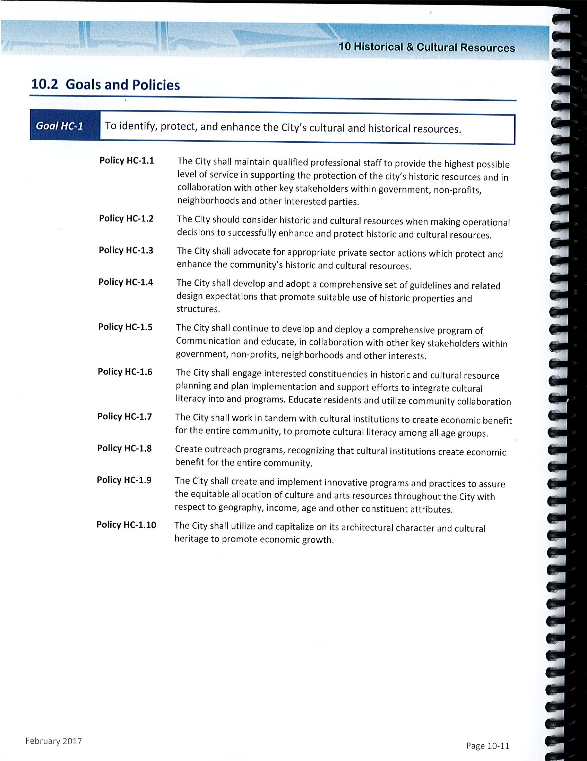
Historic and Cultural Resources Goals and Policies
Policy HC-1.3-The City shall advocate for appropriate private sector actions which protect and enhance the community’s historic and cultural resources.
Policy HC-1.10-The City shall utilize and capitalize on its architectural character and cultural heritage to promote economic growth.

Slide 21
Character of the Immediate Area or Neighborhood
Character of the surrounding area is a common planning concern. It is one of the required findings for the issuance of a variance by the Zoning Board of Review.
RIGL 45-24-41
This matter is usually analyzed by trained land use and architectural critics. Utilizing this evidence, the Board defines the character and then makes a finding as to whether or not the project will alter the character of the surrounding area.
For the purposes of demolition approval, the focus is on the architectural qualities of the building, as land use is not a focus of demolition, but development.

Slide 22
Proposed use. Many historic buildings can be adapted for a new use or updated for a continuing use without seriously impacting their historic character. However, it may be very difficult or impossible to convert some special-use properties for new uses without major alterations, resulting in loss of historic character and even integrity.
Connects with policy HC-1.10

Slide 23
Regulatory Takings
Land use controls that are restrictive to the point of a loss of all beneficial use of land (i.e. extreme property values reduction) have been judged to be an exercise of eminent domain requiring just compensation by the government actor. Typically, judges overturn the governmental act (could be the decision, but may be the law itself) and do not award damages, BUT SOMETIMES AWARD DAMAGES.
For Demolition Approval, the Board should be careful not to prevent a permitted (or specially-permitted) use of a property

